Slide 1
Find the facts.
Expose the story.
Change the system.
Notes:
Quick GW overiew

Slide 2
© Global Witness
Notes:
(Note – photo from 2004, not 90’s.) Soldiers escorting illegally-logged luxury timber, Phnom Aural Wildlife Sanctuary, May 2004.

Slide 3
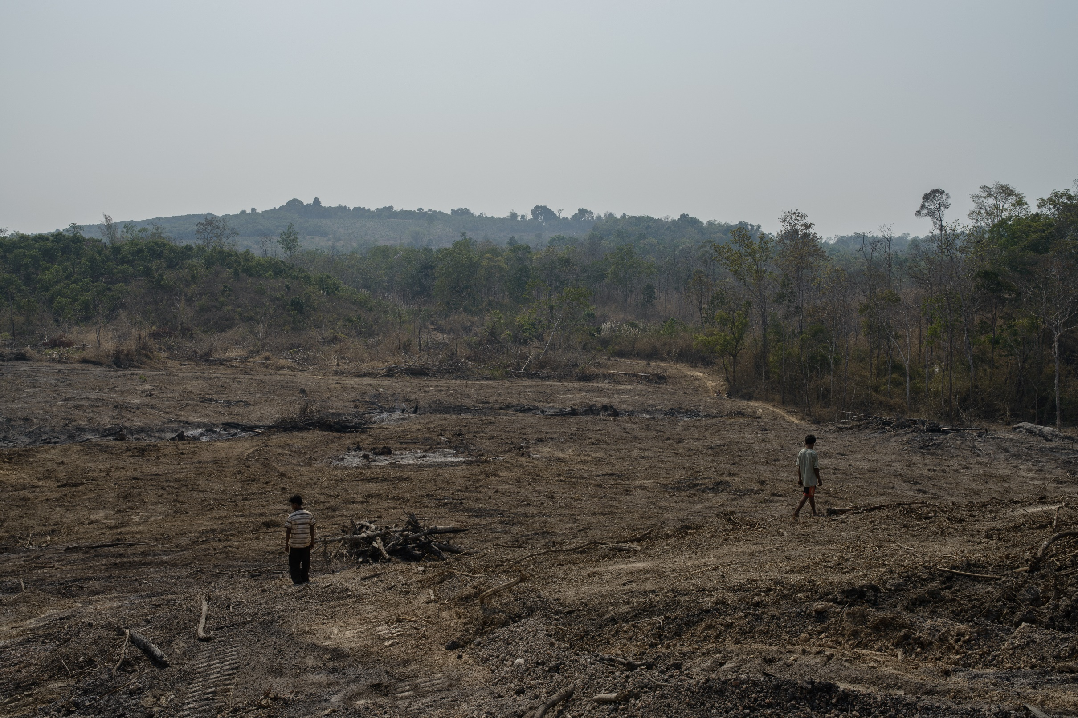
© Global Witness/Chris Kelly
Notes:
Note – this is an example of the devastation caused by illegal logging but not from the period mentioned in the presentation (2013 not 90’s).
Local residents walk through what was once forest, recently cleared to make way for a rubber plantation in Ratanakiri Province, March 2013. Credit, Global Witness / Chris Kelly

Slide 4
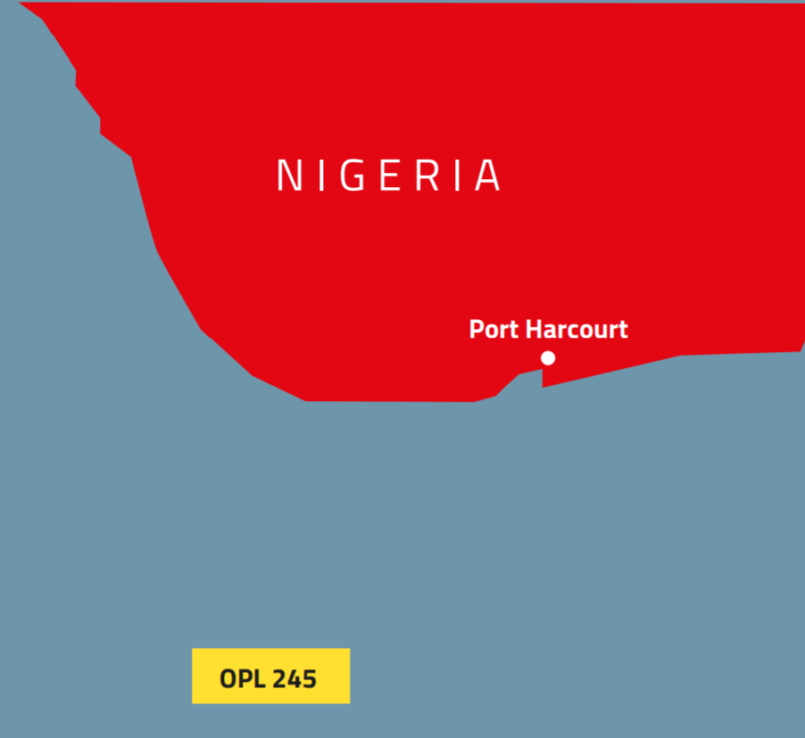
© Global Witness

Slide 6
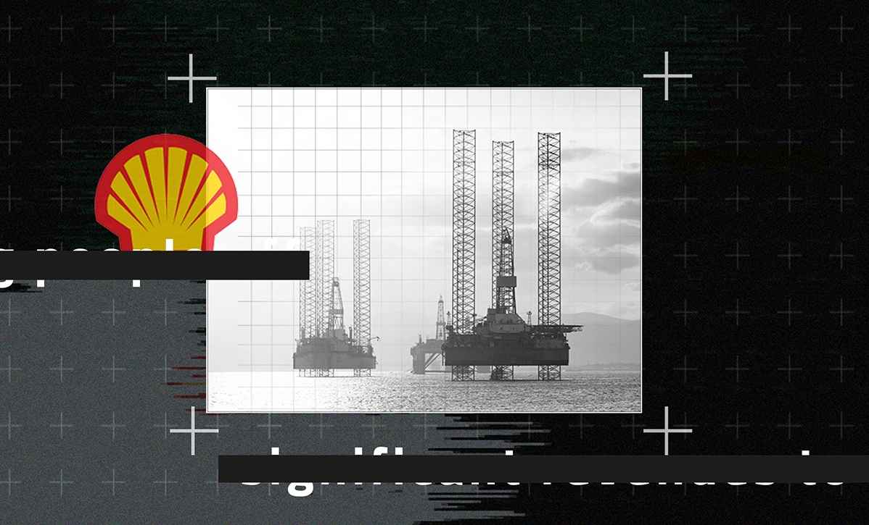

Slide 7
“Two of Vietnam’s largest companies…have leased vast tracts of land for plantations in Laos and Cambodia.
“Deals are cloaked in secrecy and they are bankrolled by international finance such as Deutsche Bank and the International Finance Corporation.”
Rubber Barons Global Witness

Slide 8
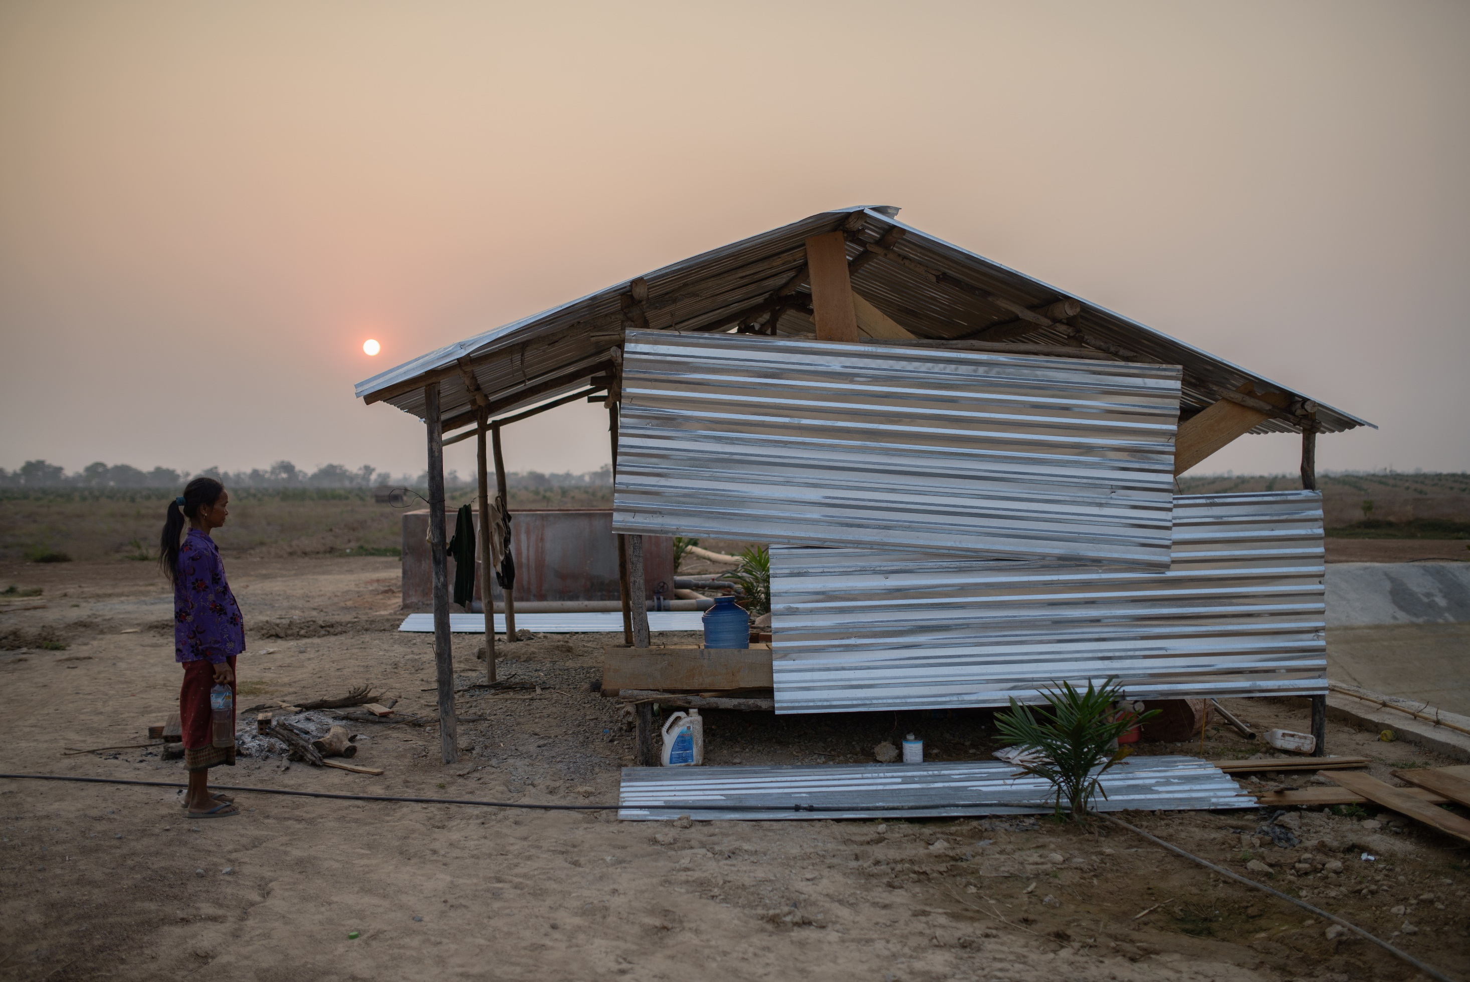
© Global Witness/Chris Kelly
Notes:
An indigenous woman stands next to pumps used for irrigation in a HAGL plantation, Laos. In Rubber Barons, Global Witness documents the devastating impact of Vietnam’s rush for rubber on local communities in Laos and Cambodia.

Slide 9
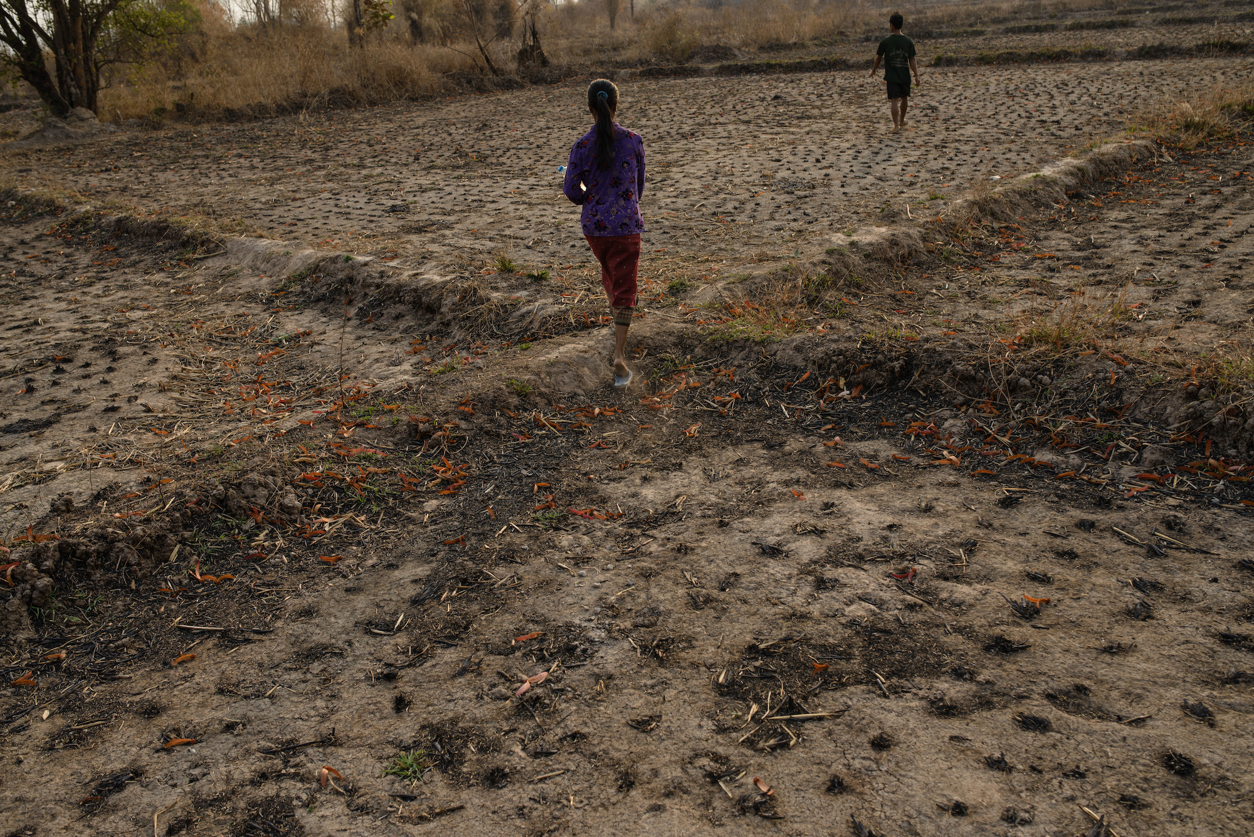
© Global Witness/Chris Kelly
Notes:
Local residents walk through what was once forest, recently cleared to make way for a rubber plantation in Ratanakiri Province, March 2013.

Slide 10
“Losing the forest is like losing life.”
A village elder describes the impact of Hoang Anh Mang Yang’s forest clearance
Rubber Barons
Global Witness, 2013

Slide 11
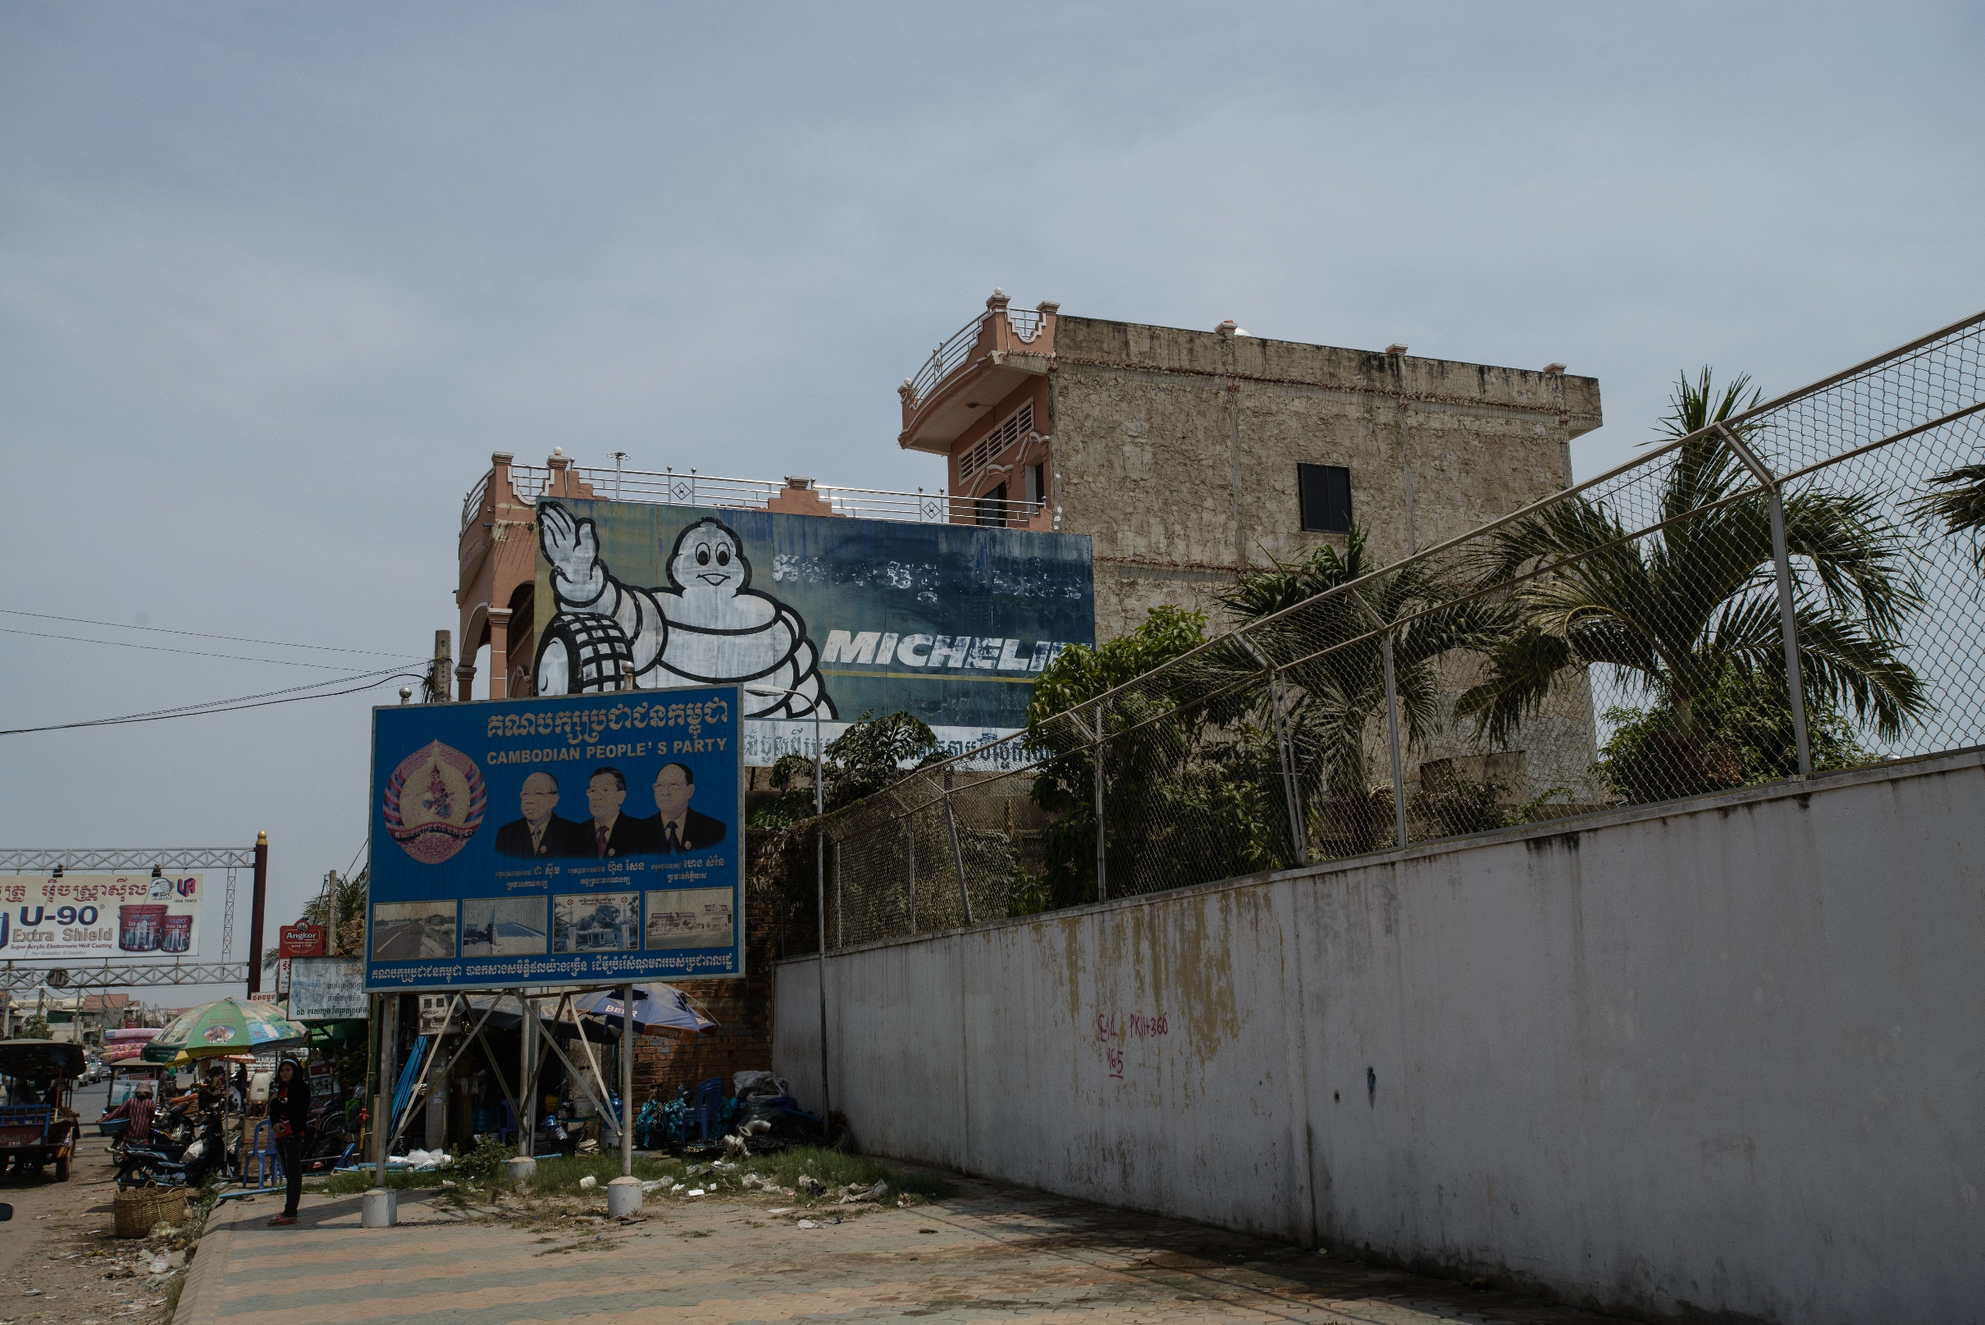
© Global Witness/Chris Kelly
Notes:
A sign for Michelin tyres seen in Phnom Penh, Cambodia. 29/03/2013

Slide 12
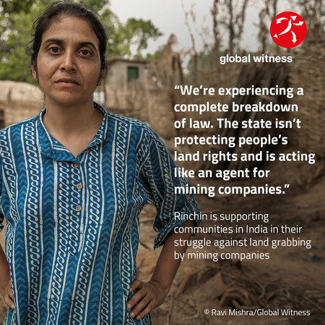
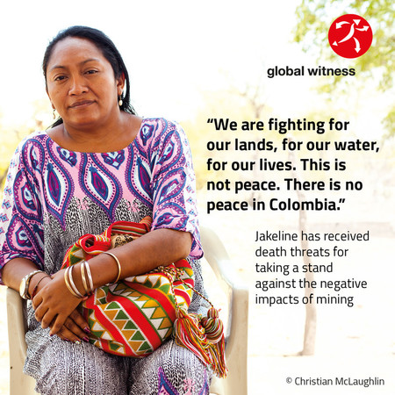
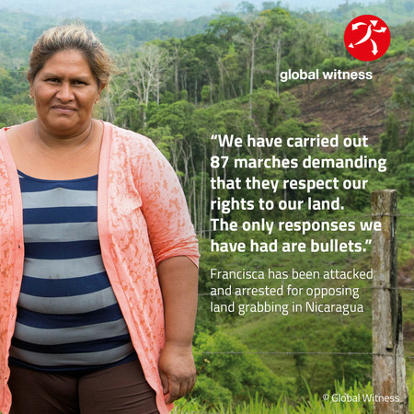
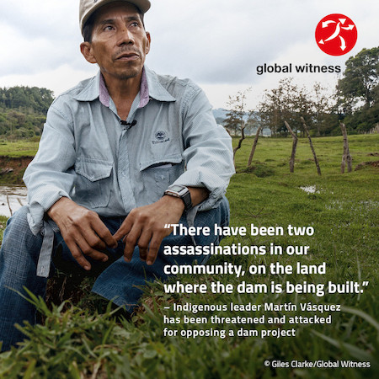
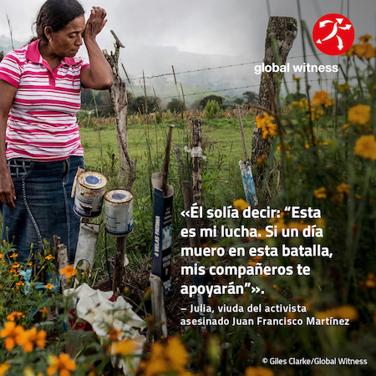
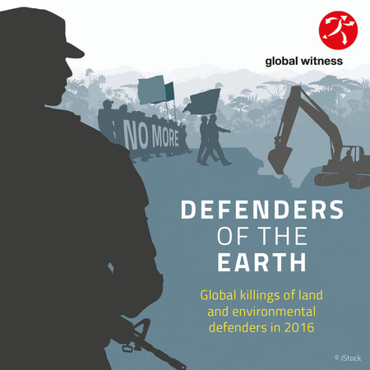
Notes:
Image: Shots of some of our campaigns

Slide 13
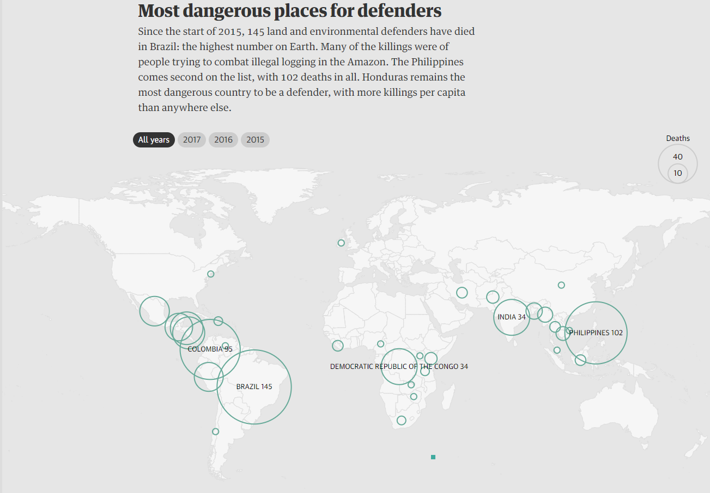
Notes:
Image: Still image of maps - incase video doesn’t work

Slide 14
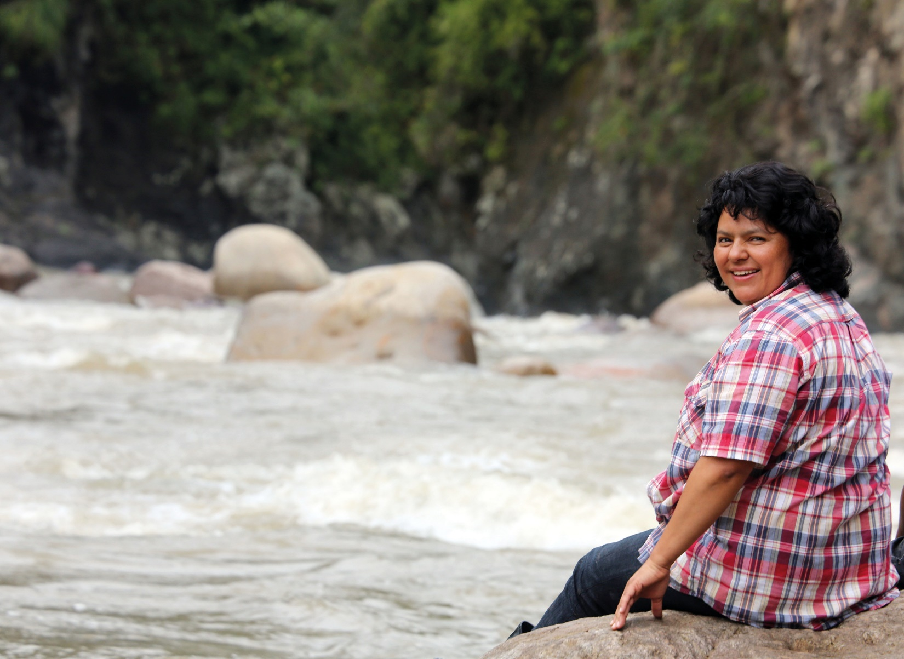
© Goldman Environmental Prize
Notes:
Berta Caceres sits at the Gualcarque River in the Rio Blanco region of western Honduras

Slide 15
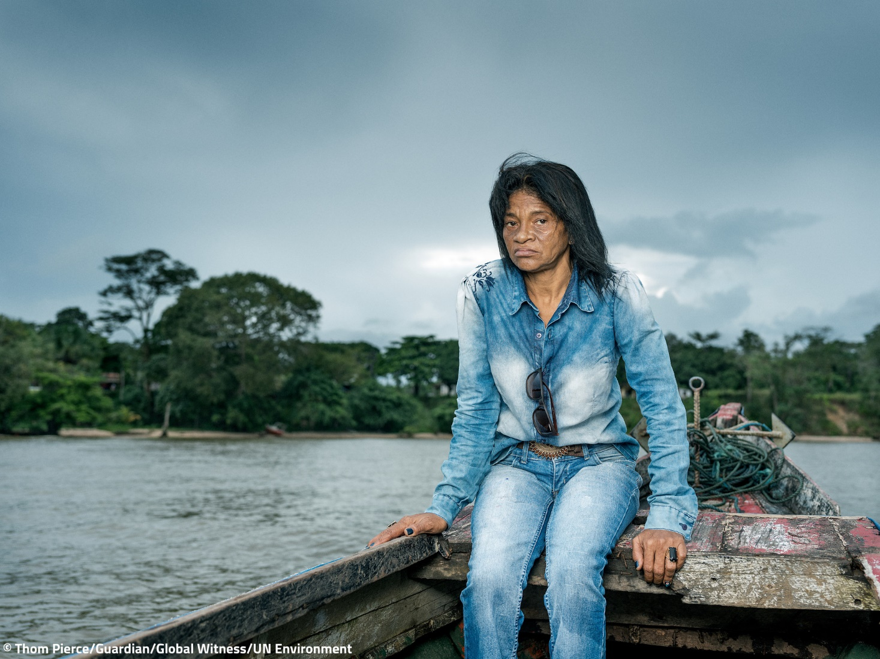
© Thom Pierce/Guardian/Global Witness/UN Environment
Notes:
Maria do Socorro campaigns with communities against hydro aluminium factories which are allegedly responsible for water poisoning in the town of Barcarena.

Slide 16
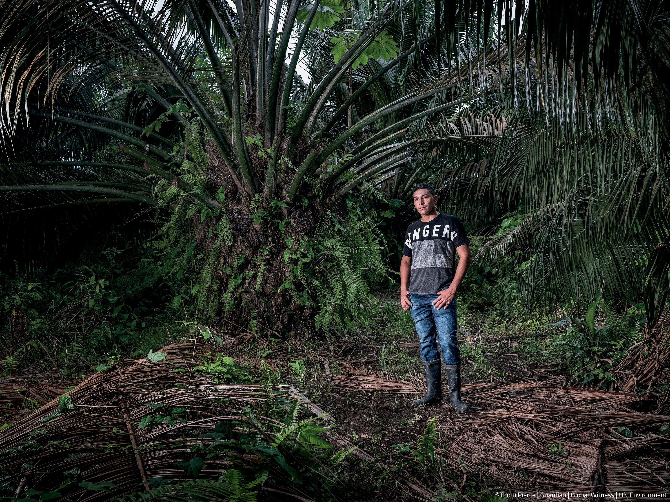
© Thom Pierce/Guardian/Global Witness/UN Environment

Slide 17
www.globalwitness.org/defenders

