Slide 1
Sustainable, Reliable and Transparent Data and Information towards Responsible Land Governance (CO-TRAIN): Updates from ASIA
Nathaniel Don Marquez
Asian NGO Coalition (ANGOC)
Global Land Forum
Bandung, Indonesia
25 September 2018
14:00 – 16:00; AMATAP B

Slide 2
Asian NGO Coalition (ANGOC) & Land WATCH Asia (LWA)
ANGOC is a regional association of 15 national and regional networks of NGOs in Asia actively engaged in food sovereignty, land and resource rights, smallholder agriculture towards sustainable food systems and livelihoods, participatory governance and rural development.
LWA is a regional network of CSO land rights advocates and practitioners from 7 Asian countries that aims to ensure that access to and control of land, agrarian reform and sustainable development for the rural poor are addressed in national and regional development agenda

Slide 3
Context
Trustable land information system is fundamental for responsible land governance.
Access to timely and reliable information on land rights democratizes land governance.
Sustainable, transparent, and reliable data empower people, influence policies, and support sustainable development

Slide 4
LWA Land Monitoring objectives and Framework
To increase CSOs’ capacity to monitor access to land implementation, landlessness and land conflicts;
To use the data gathered and analyzed as inputs to land rights campaign

Slide 5
INDICATORs
LAND TENURE
Land Disputes
Number of people killed
Number of people detained
Number of people harassed
Number of cases received
Number of cases investigated
Number of cases adjudicated
Number of cases of land grabbing
Percentage area of land grabbed
Average time in years for dispute resolution
Additional indicators:
Annual loss due to disputes
Monetary loss
Evictions
Number of households evicted/ displaced from farms
Number of households becoming totally homeless because of eviction
ACCESS TO LAND
Ownership
Land ownership distribution by size
Gini coefficient/ bottom-to-top ratio (for analysis)
Tenancy Rights
Number of sharecroppers
Percentage of sharecroppers with legal documents
Percentage of contract farmers’ area in relation to agricultural area
Landlessness
Gini coefficient (for analysis)
Number and percentage of landless rural persons among rural populations

Slide 6
Sustainable, Reliable and Transparent Data and Information towards Responsible Land Governance (CO-TRAIN)
FES; SARRA
KPA
CSRC; MODE-Nepal
STAR Kampuchea
SCOPE
ALRD
UWUA; RDF
focal point/resource hub
XSF; PAFID, AR NOW
In partnership with the International Land Coalition (ILC)

Slide 7
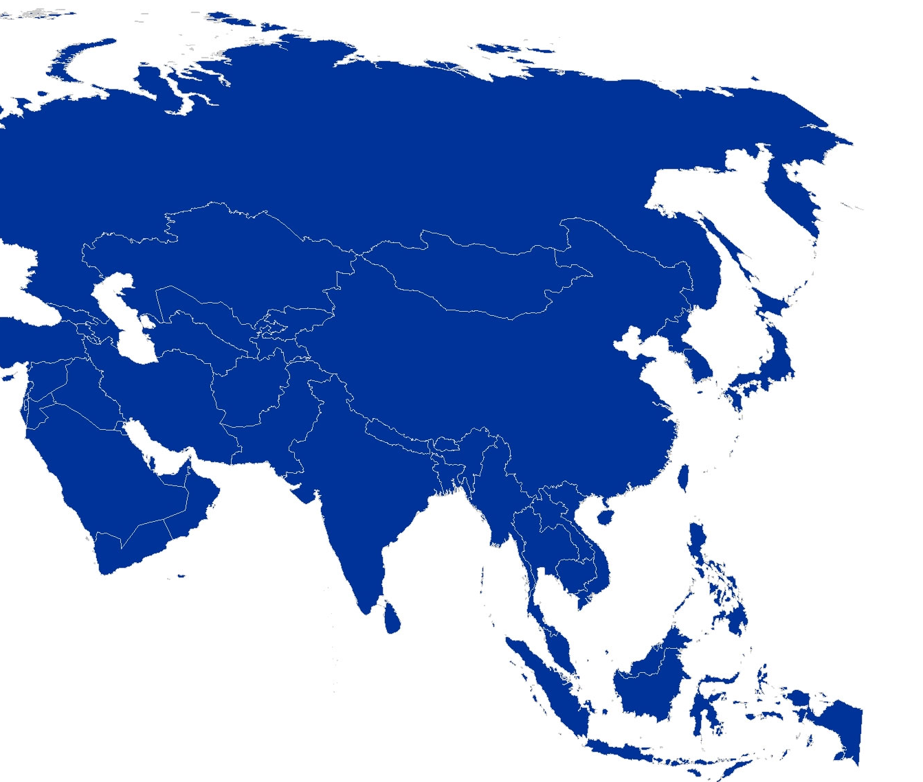
Objectives of the Initiative (CO-TRAIN)
Initiate CSO engagement with National Statistical Offices (NSO) in the framework of the SDGs;
undertake LWA Country Monitoring on access to land and tenurial security in support of policy work; and
convene and facilitate the work of the CBI #8 Working Group.

Slide 8
LINK with DASHBOARD
PCLG Commitments | PROPOSED INDICATORS | Are government data for the indicator available? | Are data for the indicator available from CSOs or other sources (specify)? | Remarks

Slide 9
THANK YOU

