Slide 1
ILC Initiatives- Integration and Dashbaord
Jagat Basnet
CSRC Nepal
Global Land Forum, Bandung
September 2018

Slide 2
Overview
ILC’s Interventions in Nepal

Slide 3
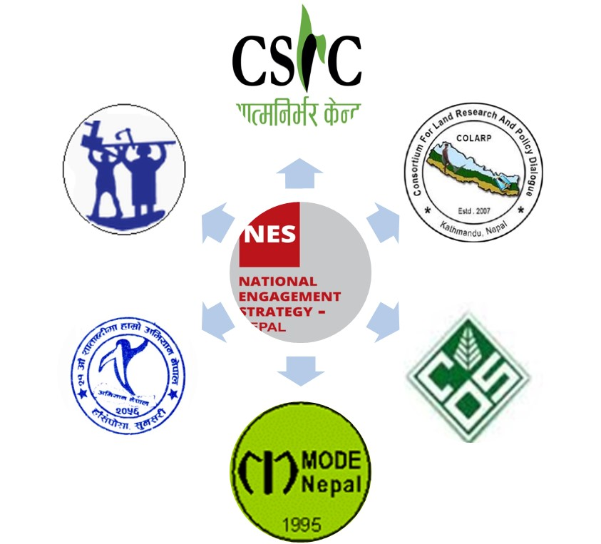
NATIONAL INITIATIVE: National Engagement Strategies to Promote and Strengthen PCLG in Nepal
Composition of NES Nepal
What NES is Doing?
Evidence based Research/Studies
Policy Advocacy
Formation & Strengthening Peoples’ organizations
Supporting Land Rights Movement
Establishing Multi-stakeholder Platform

Slide 4
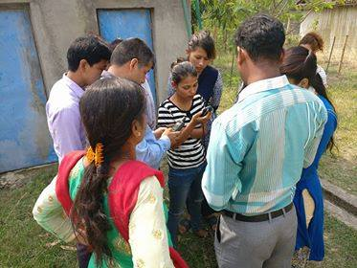
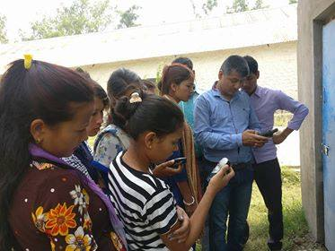
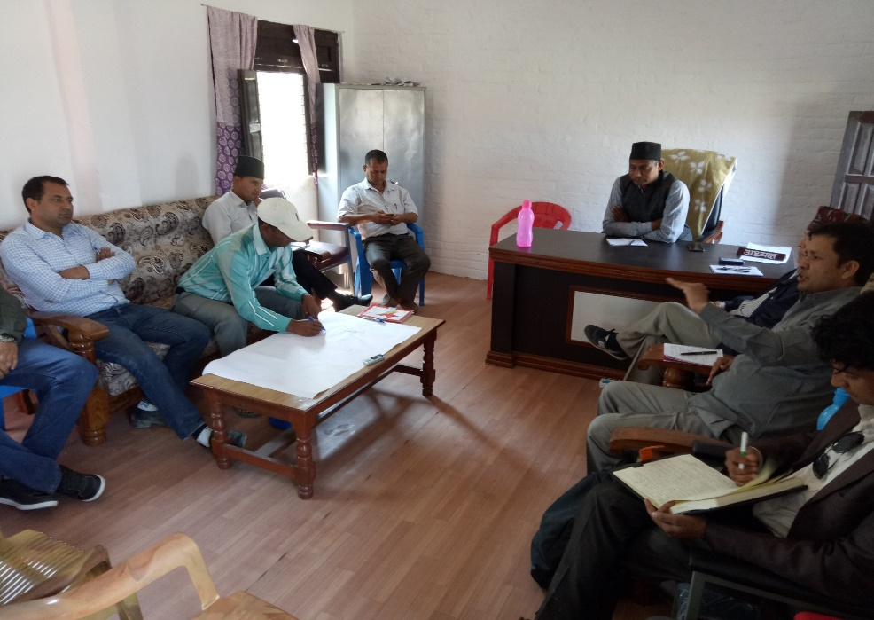
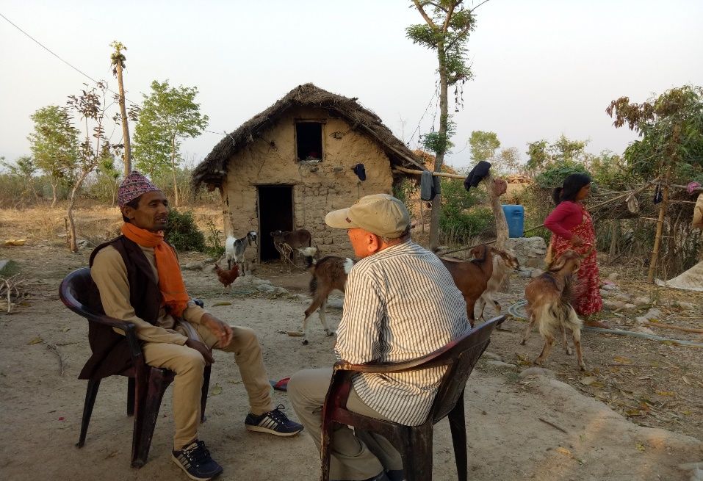
Evidence based Research/Studies
Context Mapping of Land & Natural Resources
Land, agriculture and natural resources management in local level: policy, law, institutional structure and good governance

Slide 5
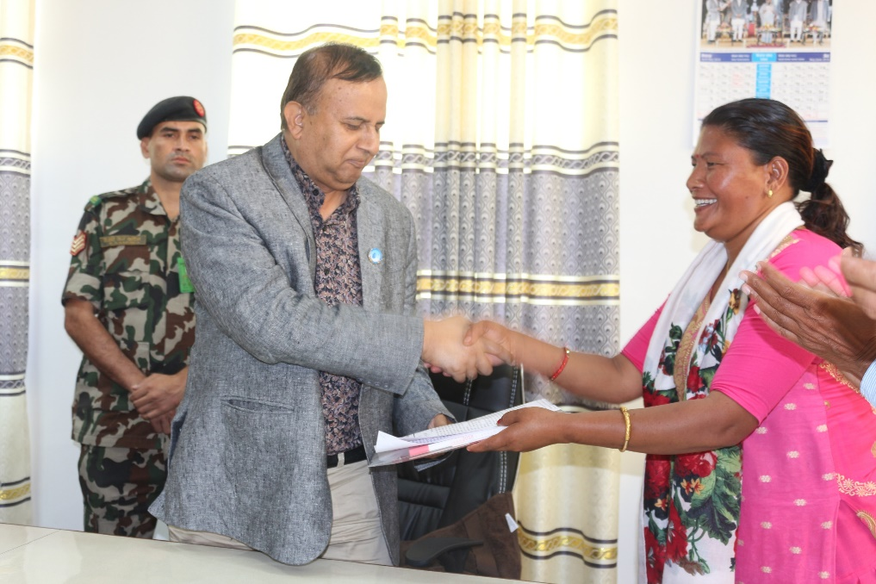
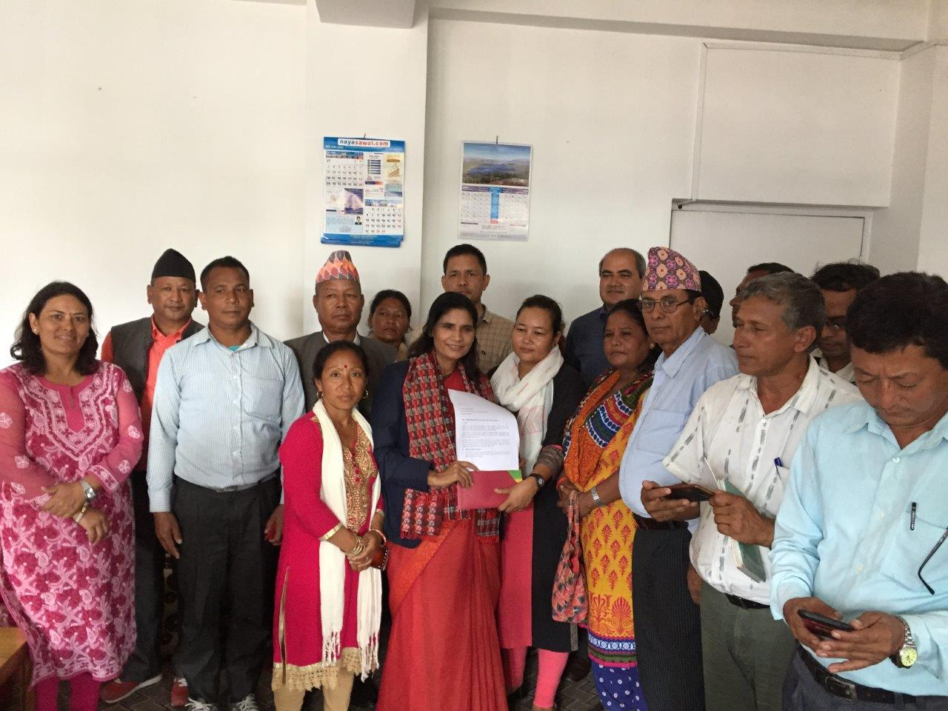
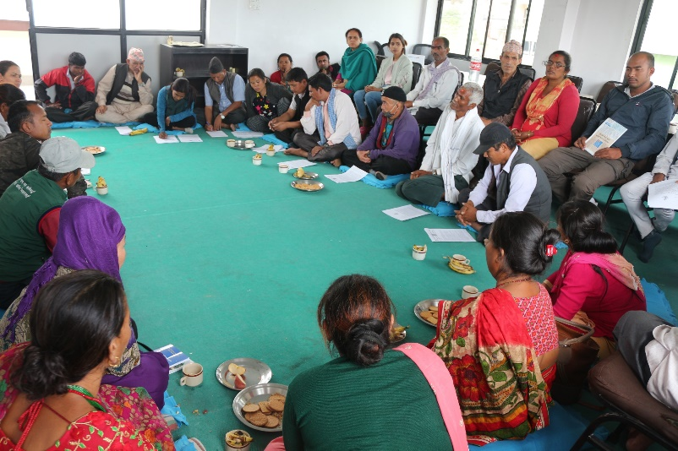
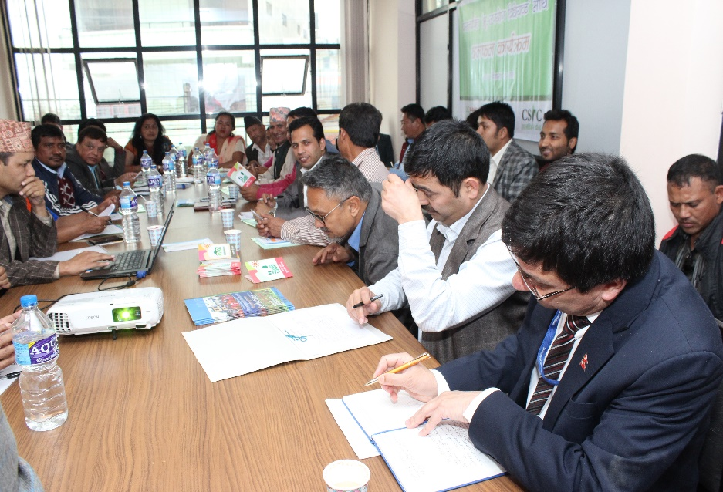
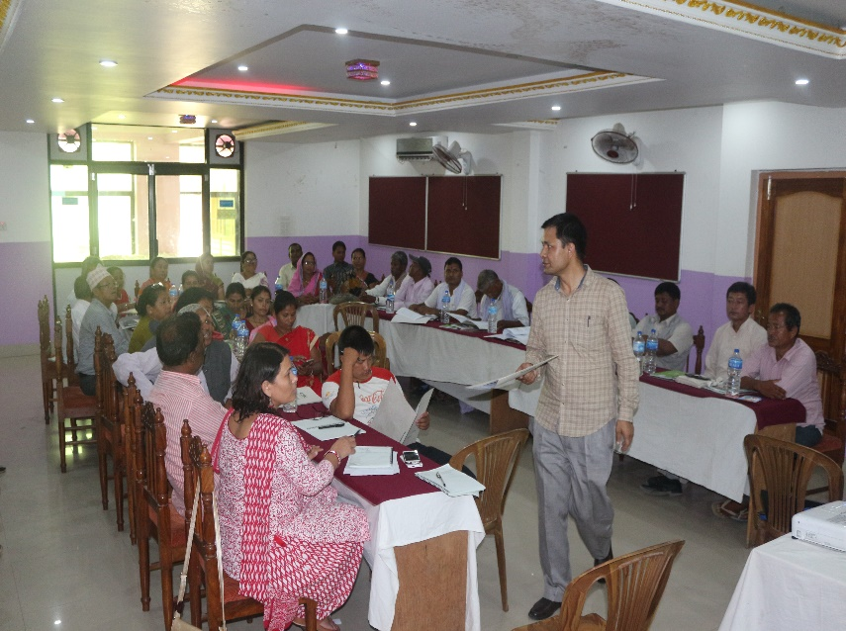
Advocacy and Consultations
Discussion with Front Line Land Activists to strategize further steps
Demand Letter Submitted to Federal Minister, MOLMPC
Demand Letter submitting to CM of Province #5
Discussion on Dalit’s Land Right
Identifying Priorities for multi-stakeholder engagement
Discussion with community people and provincial level policy makers regarding Tenancy Land Separation

Slide 6
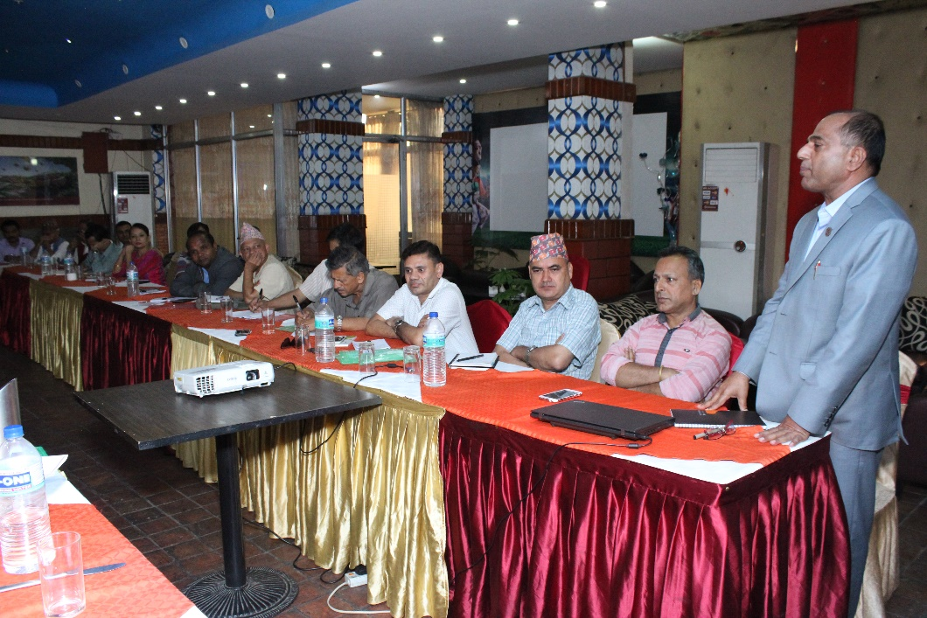
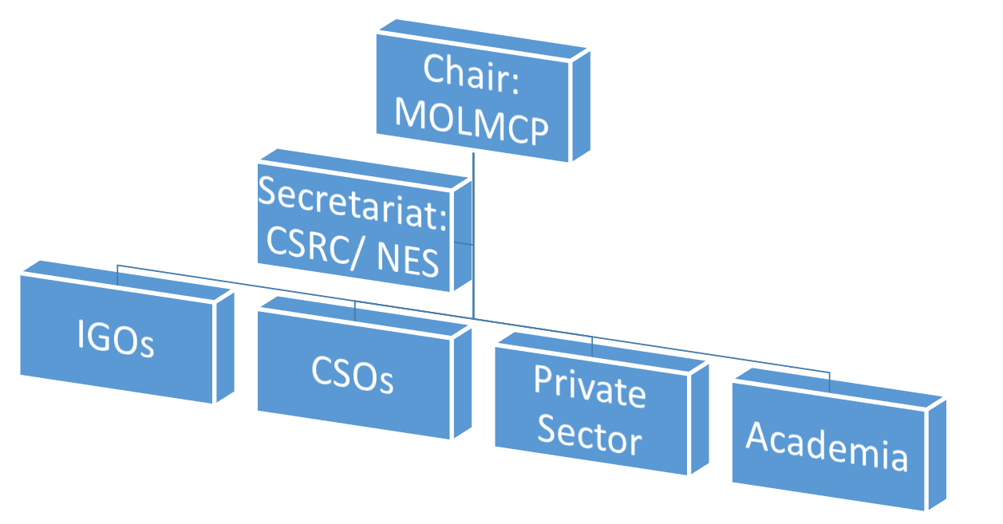
Multi-stakeholder Platform: Structure and Process
Identify critical issues and actions to advance progress towards implementation of Land related policies and plans to strengthen PCLG providing space for dialogue between the state, private sector and civil society.
Explore critical areas of common interest of diverse stakeholder regarding land governance.
Support to establish the linkages between the grass-roots (micro) and the national (macro) realities while formulating and implementing land related policies.

Slide 7
Multi Stakeholder Engagement
Provide a common platform for diverse stakeholders to build a common strategy based on complementarity of the members
Provides space for dialogue to explore and reconcile stakeholder perspectives and priorities in the land issues;
Stakeholders are expected to collaborate to support their objectives, identify common risks/ opportunities, support shared decision making and collective actions to help achieve SDGs and VGGTs
MSP:
LGWG
CSOs:
KU, TU, PU
FAO, UNDP, UNHABITAT, OXFAM, CARE, HELVETAS, HFHN,
Private Sector
MOACL, MOLD, MOAD, MOFE

Slide 8
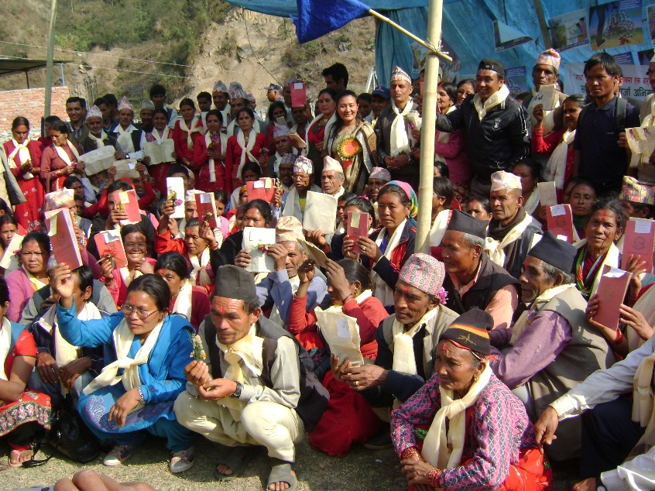
REGIONAL INITIATIVES: Commitments into Action

Slide 9
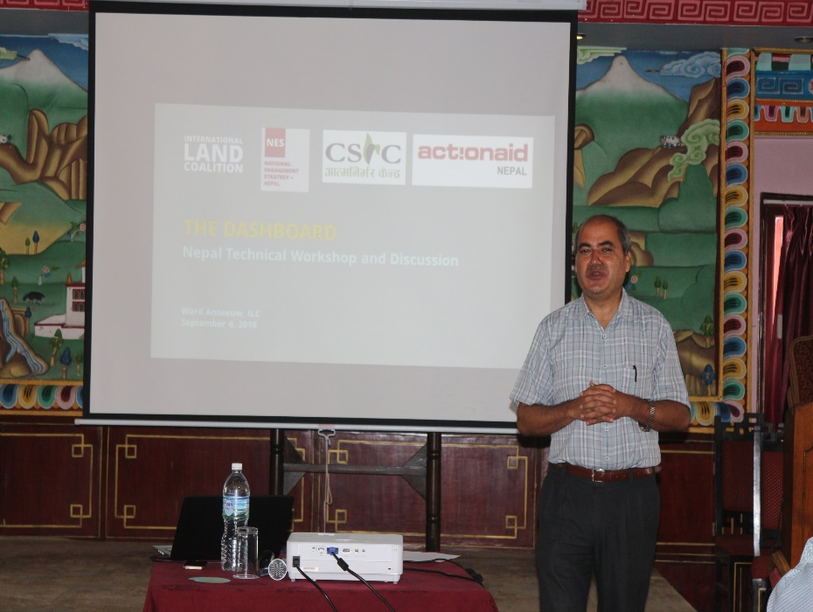
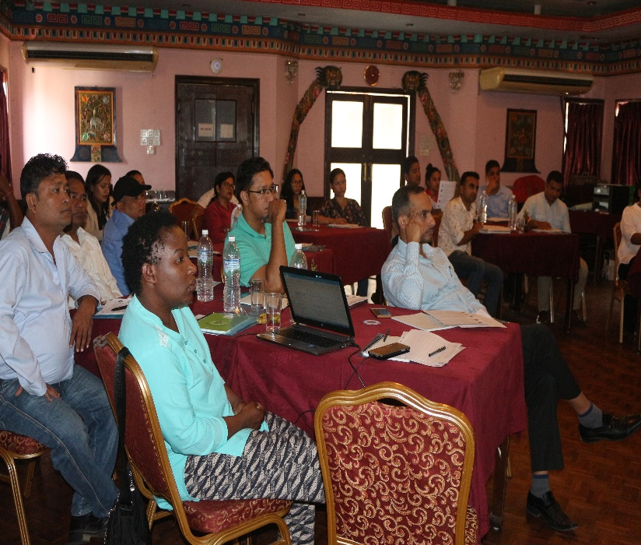
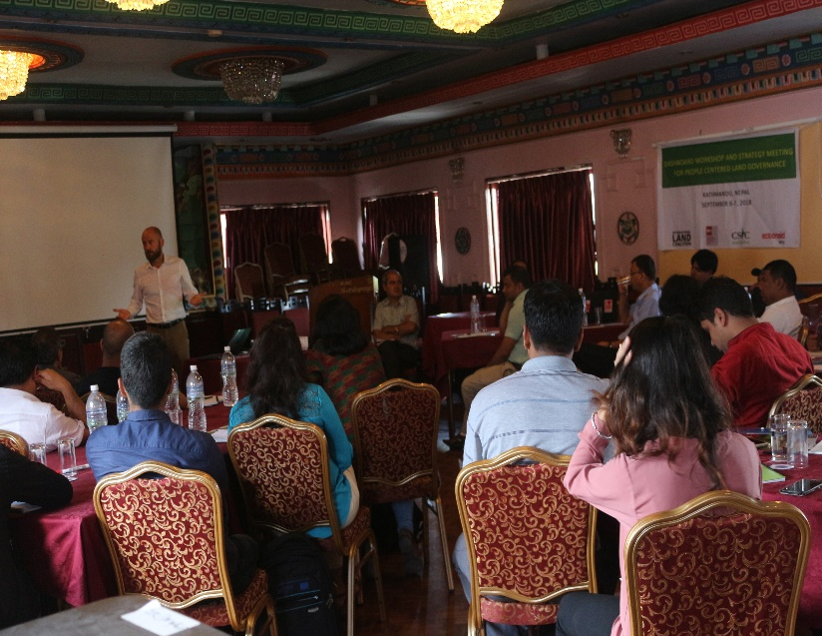
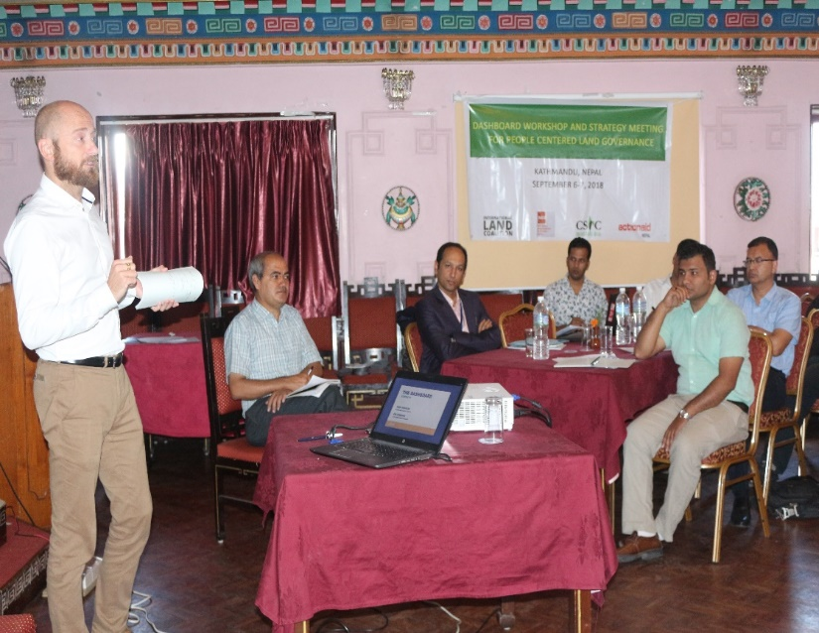
GLOBAL INITIATIVE: The Dashboard
Dashboard Launched
On 7th September 2018
To promote common indicators developed by ILC Members
Support members effort to gather people centered data
Promote inclusive data ecosystem and show how SDGs and VGGT frameworks are translated into action

Slide 10
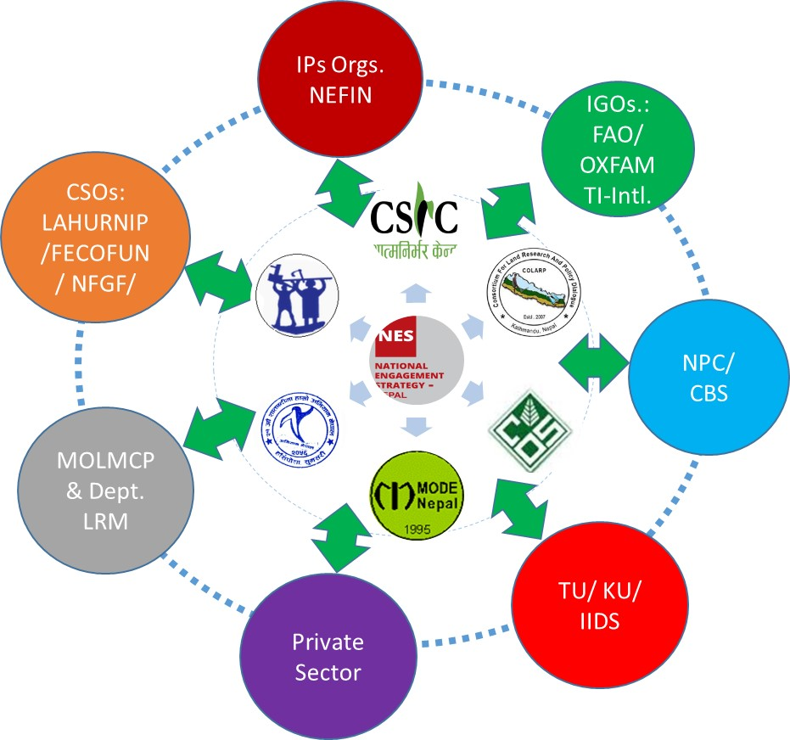
Dashboard alignment and collaborations for a data-ecosystem (preliminary)

Slide 11
Way Forward
Identify critical issues and actions to advance progress at the country level to implement PCLG.
Resource being used in land and resource related sector are so scattered and initiatives are often duplicated. Therefore, the next step to integrate efforts for larger impact will be to explore critical areas of common interest, and working areas of diverse stakeholders and build common consensus on the broader issues of Agrarian reform.

Slide 12
Way Forward
Explore innovative initiatives for capacity development and mobilization of civil society working on land issues.
Contribute to the credibility of civil society as a key change agent in PCLG
Raise land based issues vibrant at the local level to be well considered for national socio-economic and political agenda
Collaborate on People Centered Land Monitoring, particularly in the framework of The Dashboard.

Slide 13
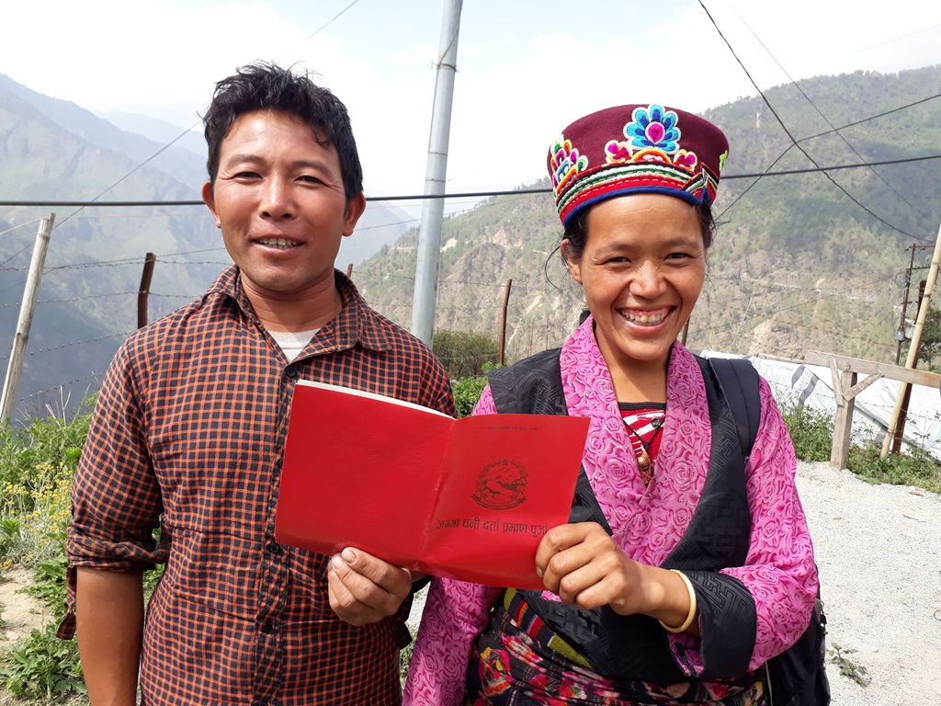
Thank you for your Kind Attention!

