Slide 1
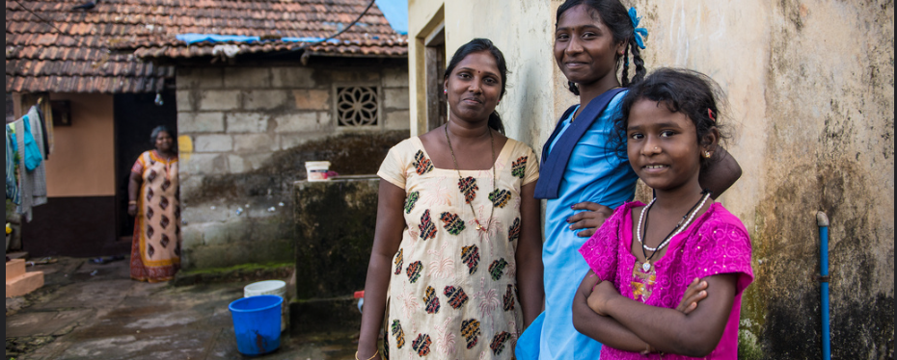
Prindex for People-Centered Monitoring
Malcolm Childress, Global Land Alliance, September 24, 2018
Notes:
1 or 2 slides on roll out and how we get to global coverage (show countries – Map?), funding secured, contacts with governments etc. Mention efforts to raise additional funds.
1-2 slides on results from 3 countries
1-2 slides on political movement building. Why does all of this get us? Able to use metrics in a new way for visibility, policy development and investment.

Slide 2
PRIndex: People’s Perceptions of their property rights – A New Global Indicator

Slide 3
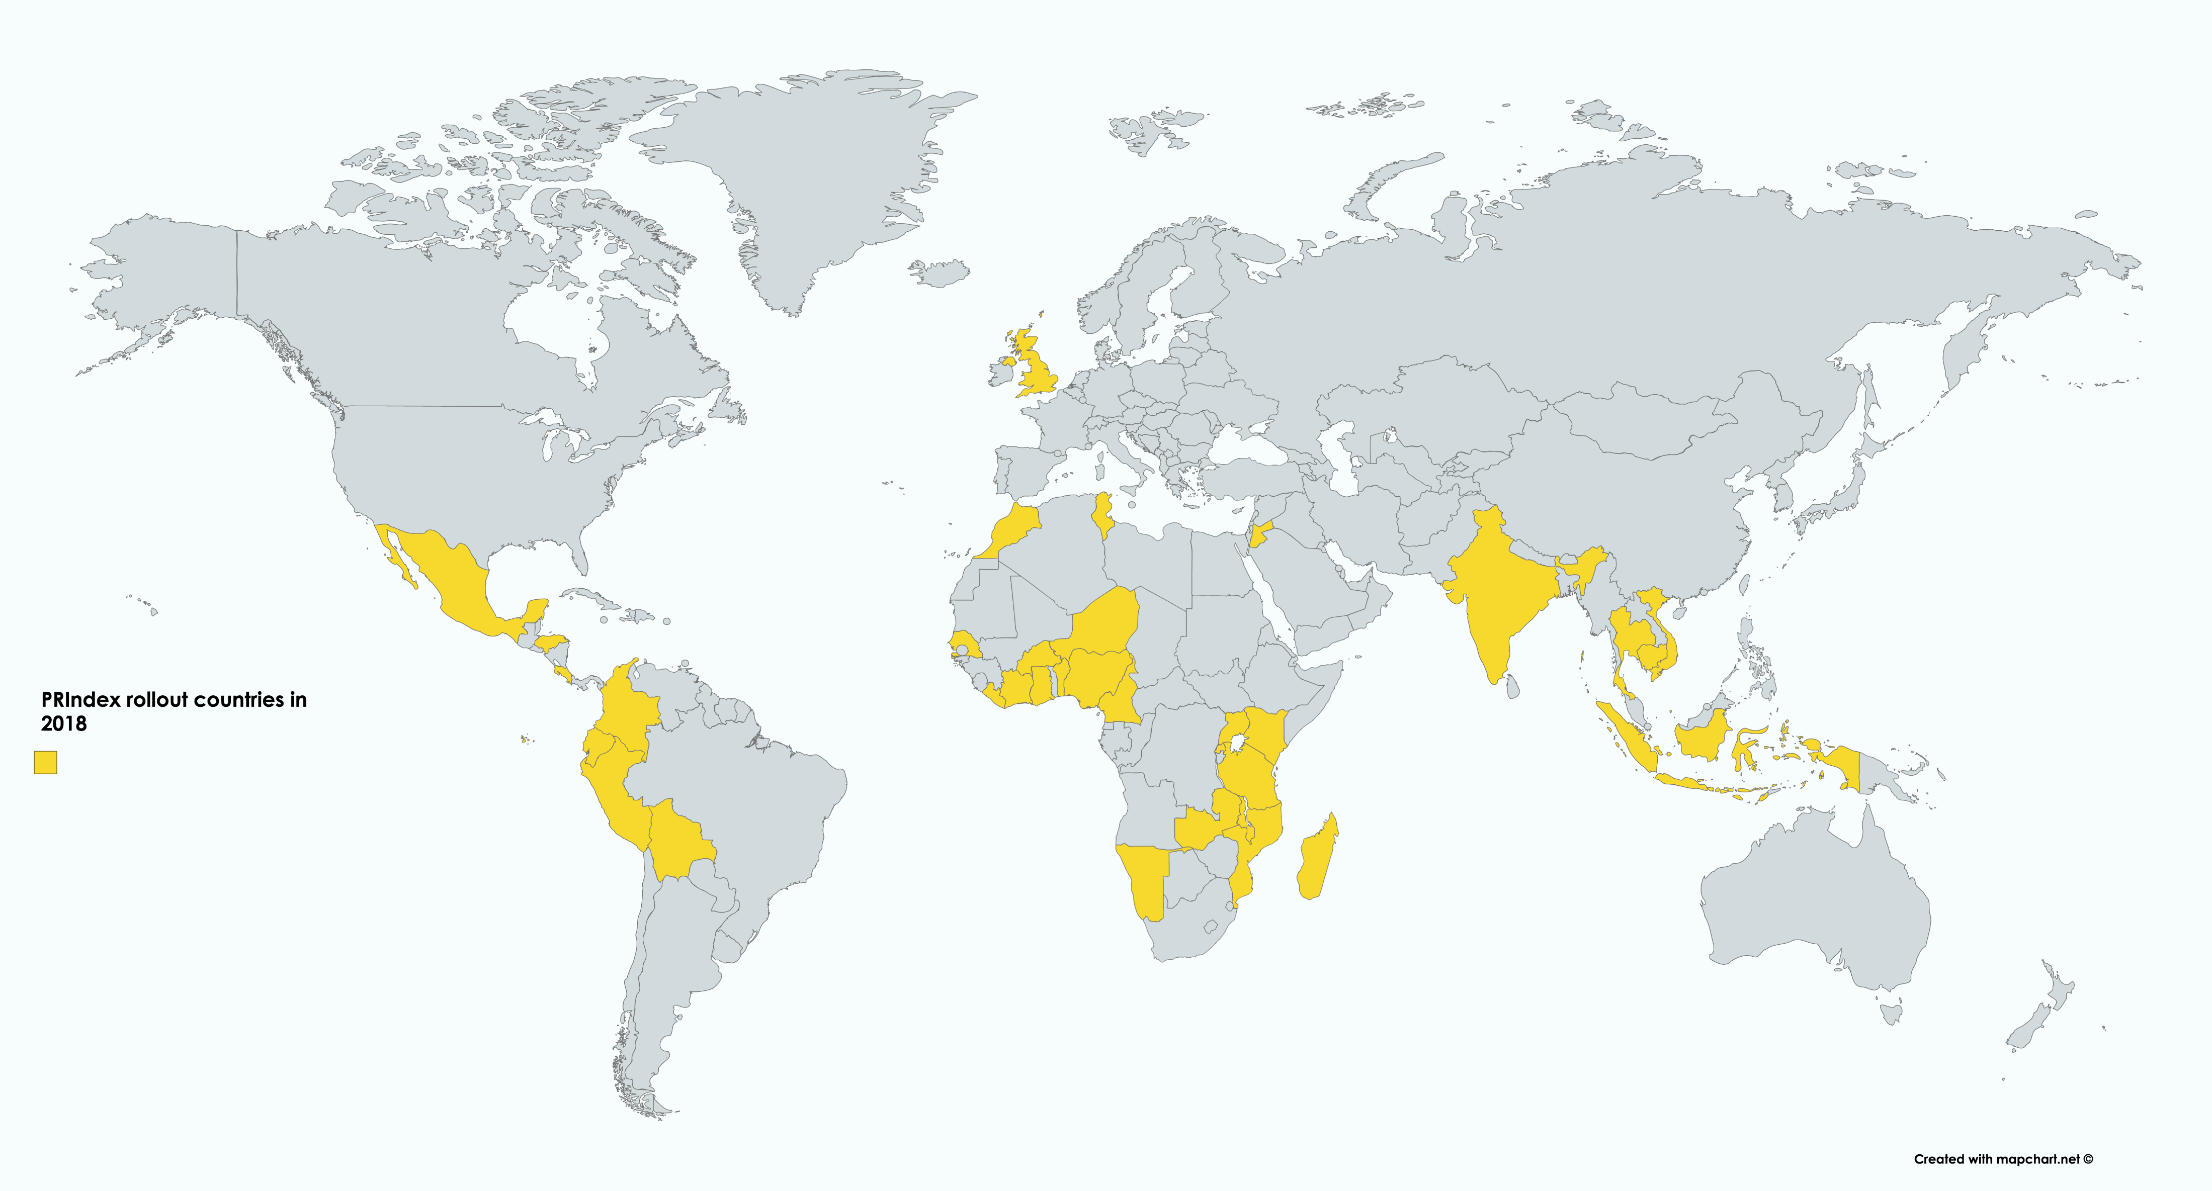
PRIndex is being rolled out to at least 33 countries in 2018….
….. And is looking to expand to 140 countries by 2020.

Slide 4
Findings from 3-country test: Colombia, India and Tanzania
Colombia
India*
Tanzania
Base: *India N=15,717 excluding Odisha (3.8% of sample)

Slide 5
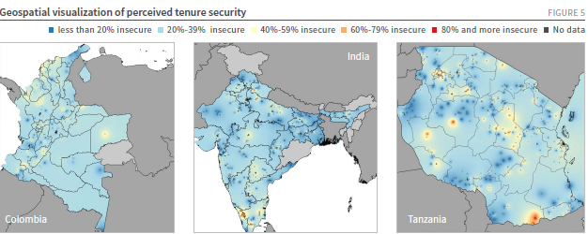
PRIndex results show differences within countries….

Slide 6
Where we are aiming….
Secure resources to expand from 33 to up to 140 countries by 2020.
Support the ILC Dashboard of People-Centered Indicators
Profile of land rights raised, supporting efforts for SDG indicator 1.4.2 to reach Tier 1 by 2020.
Provide rapid baseline of perception data for global land indicators
Governments, business and civil society organisations use PrIndex and other land indicators to develop and evaluate policies, business models and programs
Movement – building through partnerships on property rights for:
Gender equality
Inclusive Urbanisation
Poverty reduction
More resources are leveraged into land rights based on citizen-identified priorities

Slide 7
Next steps
Launch of data from first wave of 15 countries—October, 2016 at Committee for Food Security Meetings.
Collection of data in second wave of 18 countries is underway, data available December, 2018
Plan to collect data on 107 additional countries in 2019.
Regional and country engagement—what does insecurity look like in each Prindex country, and how can country partners leverage Prindex for policy activism. Webinar November 28, 2018
Local coalitions supported by local and global resources, including integrated ecosystem of indicators.

Slide 8
First wave of 15 countries—October 2018
Burkina Faso
Cameroon
Costa Rica
Honduras
Madagascar
Mozambique
Rwanda
Senegal
Thailand
Zambia
Cote D'Ivoire
Ecuador
Liberia
Peru

Slide 9
Second wave of 18 countries—December 2018
Benin
Jordan
Morocco
Niger
UK (telephone)
Bolivia
Cambodia
Colombia
Ghana
Indonesia
Kenya
Malawi
Mexico
Nigeria
Tanzania
Tunisia
Uganda
Vietnam

Slide 10
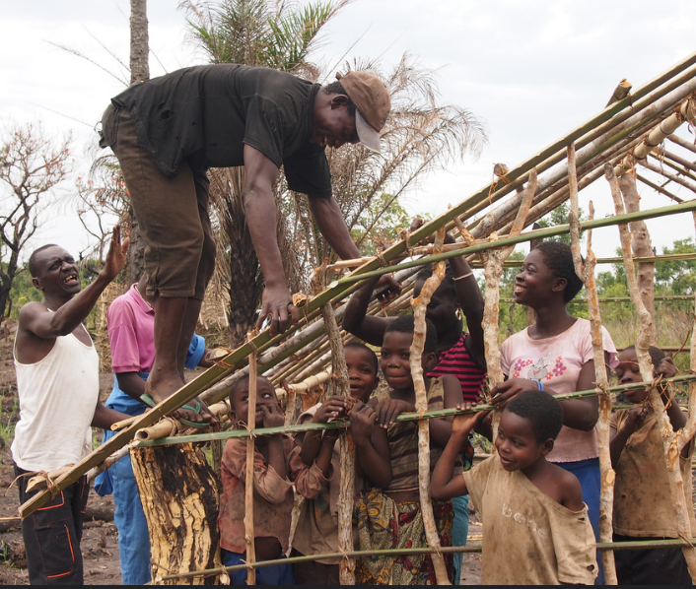
For further information go to:
www.prindex.net
@PRIndexGlobal
Sign up for our newsletter at: www.prindex.net/bulletin

