Slide 1
Economic empowerment to enhance resilience to the land in Saffa village 2018

Slide 2
Abstract:
The Arab Center for Agriculture Development (ACAD) has used different methodologies to protect the land rights of local communities in the occupied Palestinian territories, including the rehabilitation and utilization of land by planting different kinds of plants and trees. ACAD has lobbied on behalf of local farmers to protect their land rights and has facilitated activities to strengthen the resilience of target groups, in particular women and young farmers, by establishing agricultural women cooperatives in Saffa village in the West Bank. The cooperatives have strengthened the capacity of farmers to increase their incomes and sustain their agribusinesses. Furthermore, Women have received technical and vocational assistance in adding value to their Farm produce and have gained access to local market, in the other hand, the women are using their agricultural products in making homemade products.

Slide 3
Background:
Saffa is Palestinian Village, its far 18 KM from Ramallah from The western side, and 350 meter high from the sea level, the village is consists of 11731 dunum, but most it is under occupation of Israel for military base use and settlement, and reaming dunums for famers is around 1762 dunum for using different utilities and agricultural, saffa village is surrounded by settlements and discrimination walls, even of that the saffa community is made up of farmers who have an well interest in their land and cultivation even the intensive of land confiscation by Israel, in that show and in this case in order to keep the as an ILC and ACAD mission, we are in ACAD exploits our experiences to keep on the land through rehabilitate and utilize the land to strength the socio –economic situation.

Slide 4
The challenges:
Saffa village has facing different challenges especially in lands control, and sometimes the access to their land due to its nearest to the settlements which threats some farmers to farm their land specially when its pastoral, moreover, which is new strategy by Israeli that when they saw the products of farmers become mature they release wild pigs to damage the land products.
Overcoming the challenges:
ACAD has overcoming the challenges through the cooperation with community and the farmers in Saffa village and each stakeholder in the village the like the women cooperative and the local council to unify the efforts, and that’s through placing and a strategic planning in saving the land from any confiscation by Israel, and that’s through cultivating the land with different kind of agricultural products and planting it with different kind of trees to find the vitality to evade and expected threats .Moreover , Using the rehabilitation and reclamation of land as their main tools, ACAD and the local community have managed to prevent land dispossession. Furthermore, ACAD has facilitated activities to strengthen the resilience of women and young farmers, helping them to execute agricultural cooperatives, which have strengthened their livelihoods and
Agribusiness capacities. Through the cooperatives, farmers have received technical and vocational training in adding value to their agricultural produce and are able to sell their products at the local market.

Slide 5
Moving towards People land Governance:
In order to save the land from any threats, or occupation actions, the villagers of Saffa village has encouraged their families and farmers to rehabilitate and to fence their lands to cultivate it with different kind of agricultural products after giving the farmers different of awareness campaign about the value of the land in addition to the training session on the agribusiness project to improve the live hood of the community and to stop the youth immigration from the village through finding job opportunity for them as a main core to prevent any land confiscation.

Slide 6
The good practice in simple steps:
Conducting assessment “SOWT ANALYSIS”:
ACAD experts met all of the stakeholders in the village to diagnose and to see the scope of interest youth, capacities, environment, women, natural of land, settlement around, attacks, incomes, crops, trainings needs, marketing, land reclamations, rehabilitations, ministries related, organization, by all of these actors ACAD finding the gaps that could fill it to be suitable for the villagers.
Building up business plan:
In order to start in completing and to fill up the gap that we had diagnosed in assessment period, ACAD experts in programs department starts building up the business plan and action plans to go forwards the steps of working explaining the duties and rights of the all participants, taking into consideration, the expected impediments that’s farmers faced during the work and allocated solutions in saving the lands by using the updated agricultural methods like the environmental agricultural
Establishing the cooperative. Umbrella of work and actions:
It’s the way to organize the work between members and farmers within the village and the ways of identifying the relation with stallholders in the village aiming to identifying the united programs in keeping the land and supporting farmers technically and financially in implementing the agricultural programs.

Slide 7
Using land:
ACAD worked with local communities to priorities the utilization of land. Through its utilization, communities are able to secure their livelihoods increase their incomes, and ensure that their land is protected from confiscation by the Israeli government.
Training skills:
Famers of the village were trained on adding value to their agricultural products, in cooperation with local council and the organizations of village.
These skills have drawn up all the economic techniques to develop their own agricultural activities , from these training – business plans preparing – saving and credit – cooperation principles – environmental agricultural – all if these training skills in order to reinforce the resilience of farmers in their lands to protect it from any marginalization .
Marketing:
In order to sustain the process of the agricultural development as well as maintain the land from any threats, we are at ACAD team had initiated and finding marketing channels to market the farmer products in the local market.

Slide 8
Three factor of success and replicability
Cooperation:
During and after of our implementation of the allocated and designed activities, ACAD felt of optimistic feeling between the stakeholder in the village like cooperative members, residents, farmers and organization. This feeling of diapason has reflect as positive action and impact in the core implementation in the land investment by using agricultural techniques .
ACAD conducted scientific workshops and trainings for local people in order to enhance their understanding of the purpose of land rehabilitation when communities understand the end goal of their efforts they can own the process and contribute to the protection of their land rights.

Slide 9
Addressing urgent needs:
After urgent assessment by ACAD on the urgent needs for Saffa village, ACAD finds two scenarios in order to keep on land own right:
The first scenario is to complete the capacity building of all farmers in Saffa village under the umbrella of cooperative (like addressing different training related).
The second scenario is to cultivate these lands after rehabilitate it by the using the methods and the capacities of farmers.
Joint efforts by state and non-state actors:
The Palestinian government and non-state actors worked together to protect the
Land rights of their people. They have undertaken regular field visits to Saffa village, and have used social and formal media, to
address the plight of local communities.
Note:
This program is funded by Cergy Municipality in France.

Slide 10
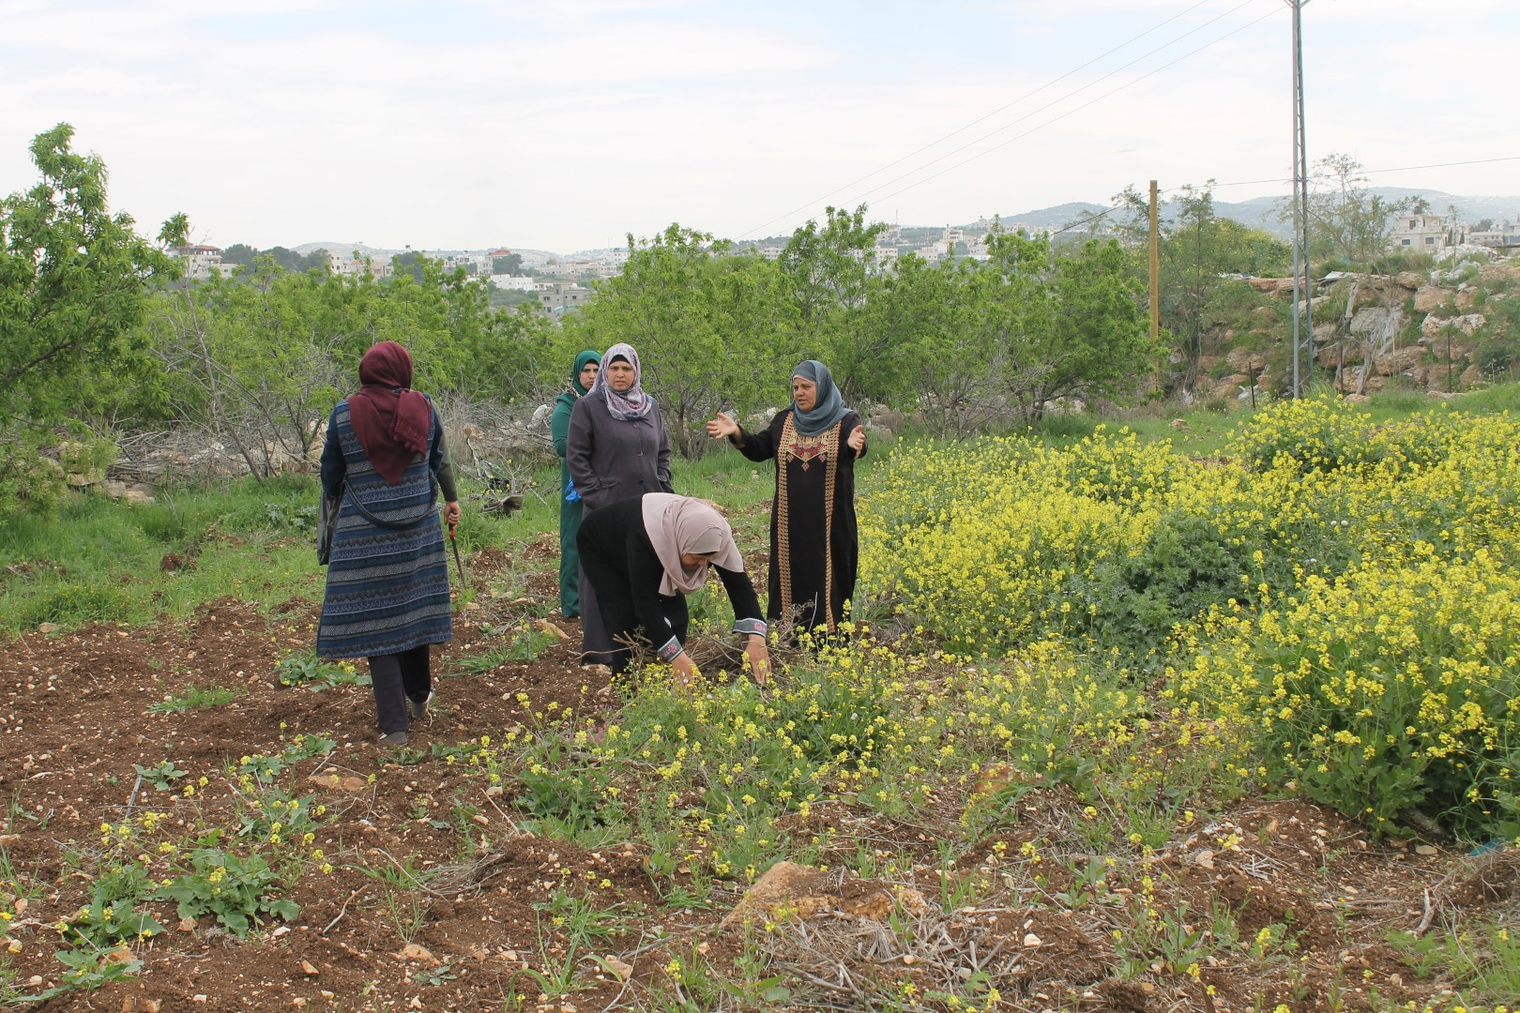

Slide 11
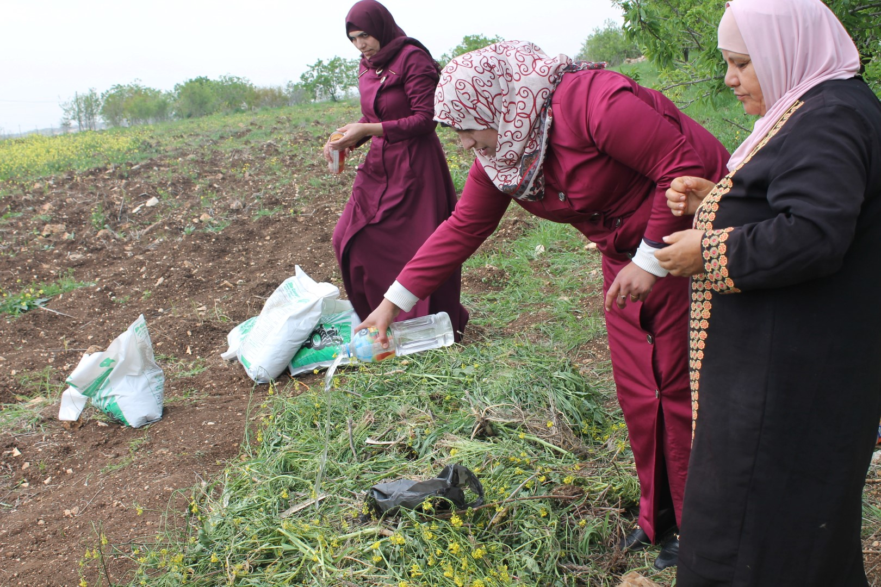

Slide 12
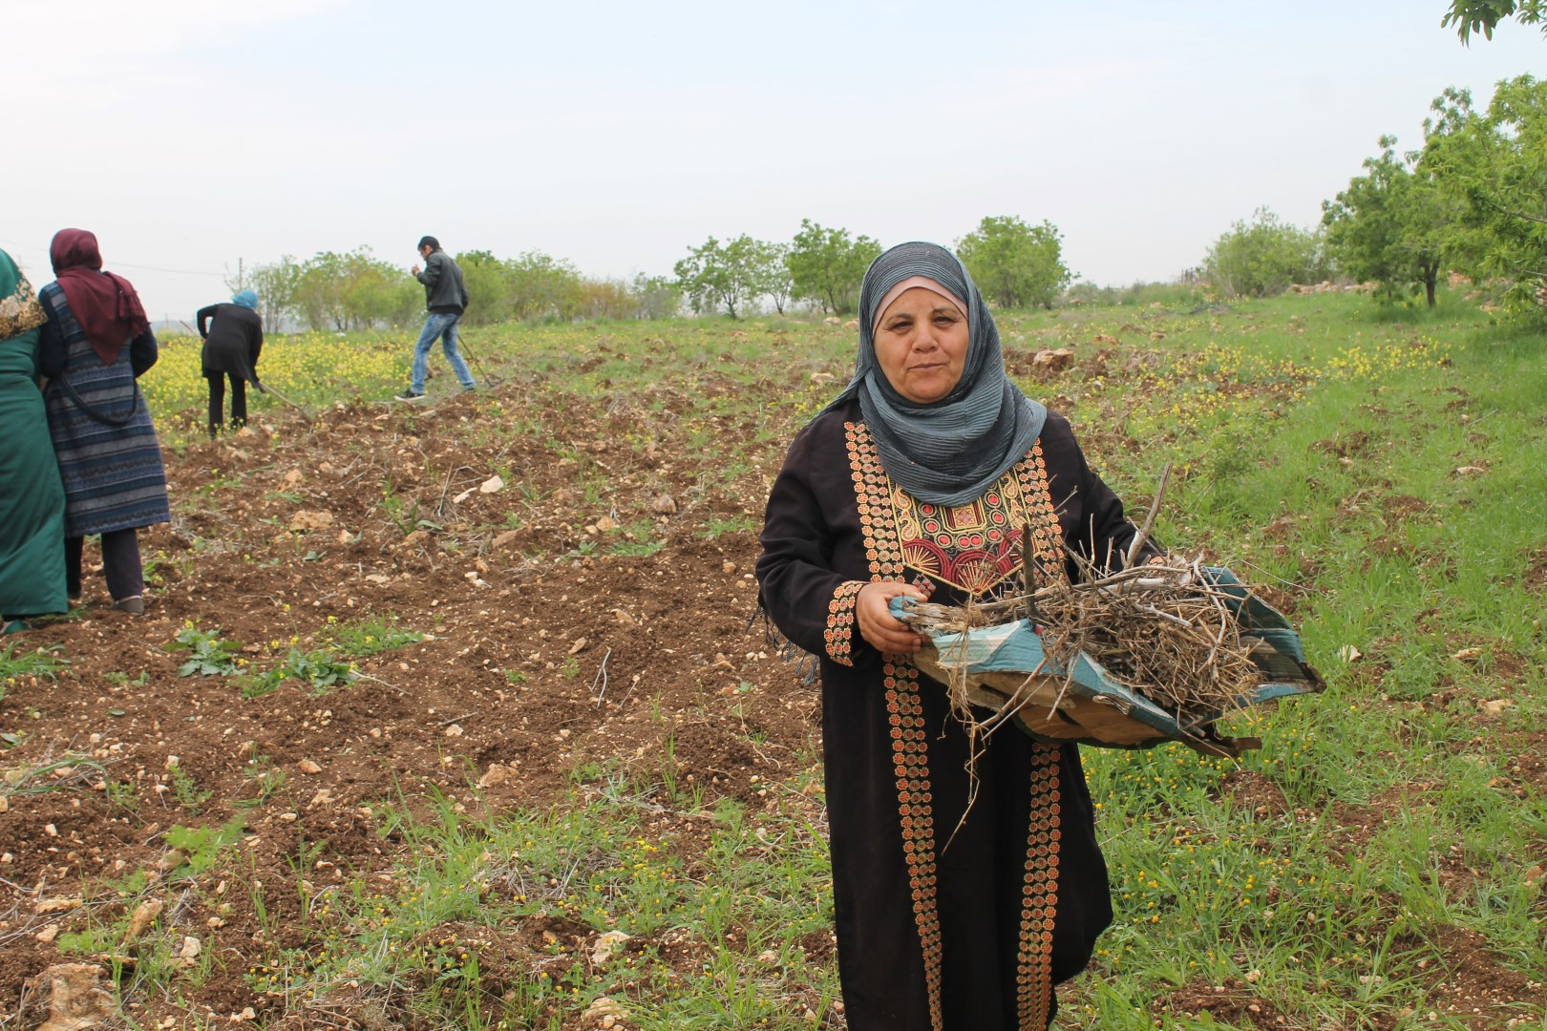

Slide 13
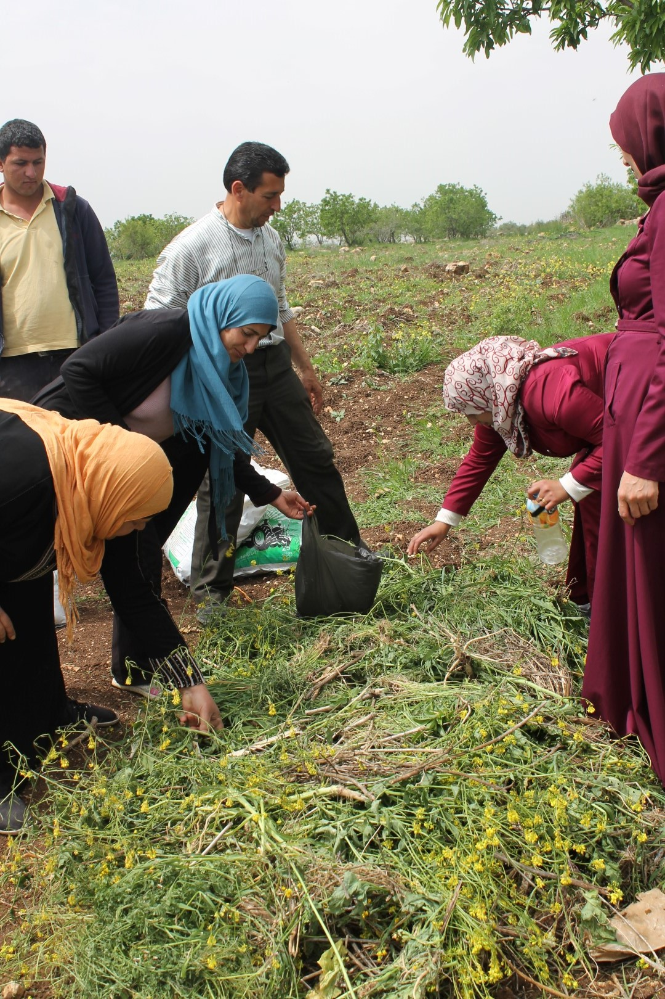
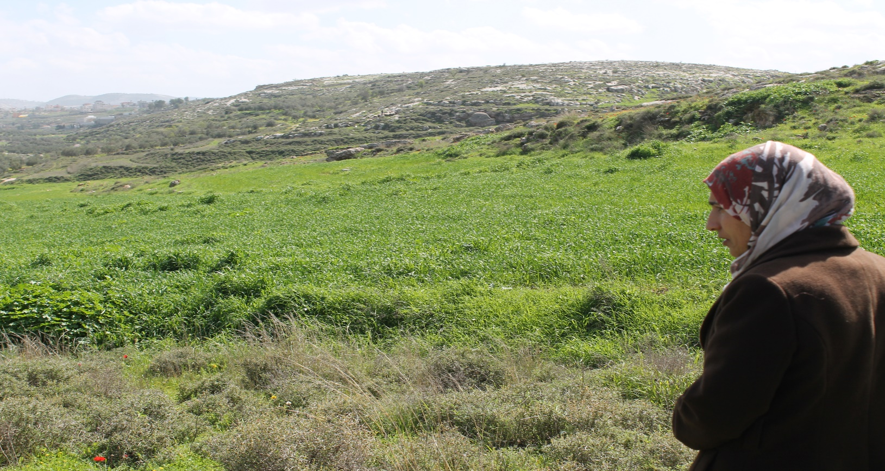
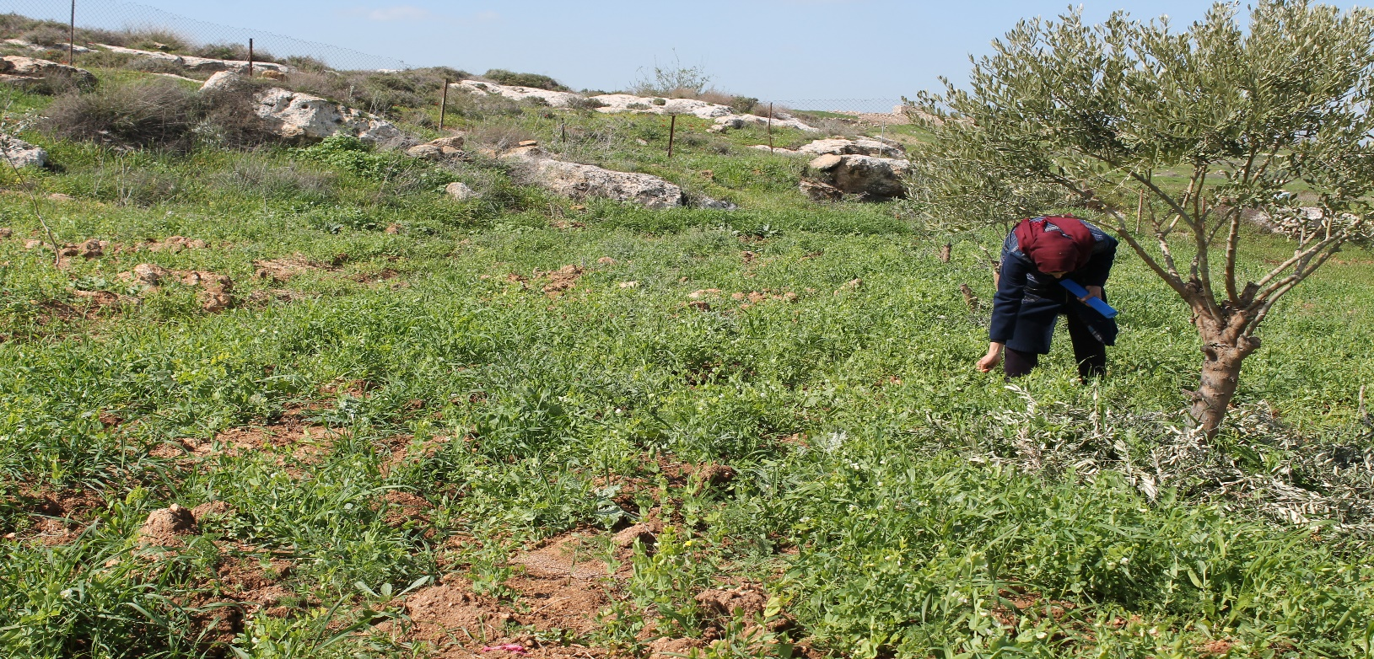

Slide 14
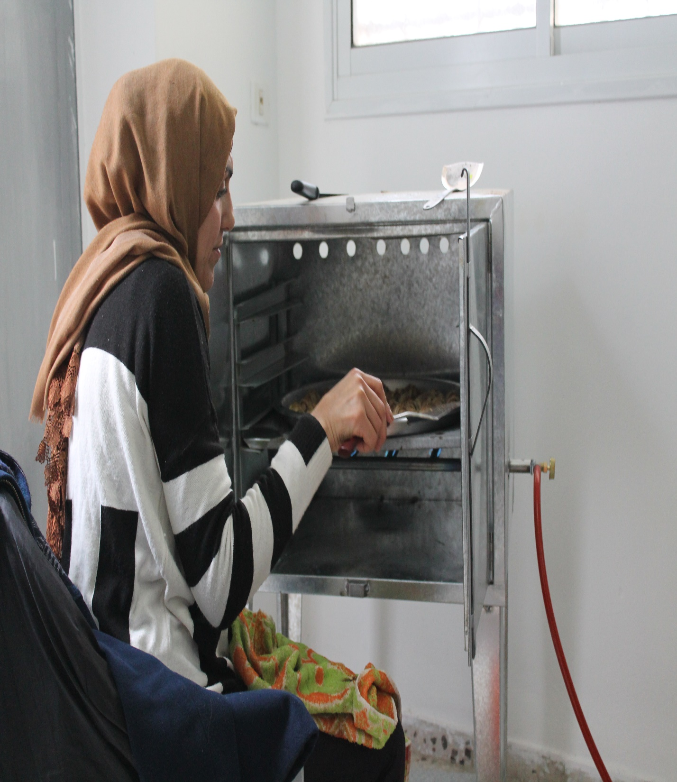
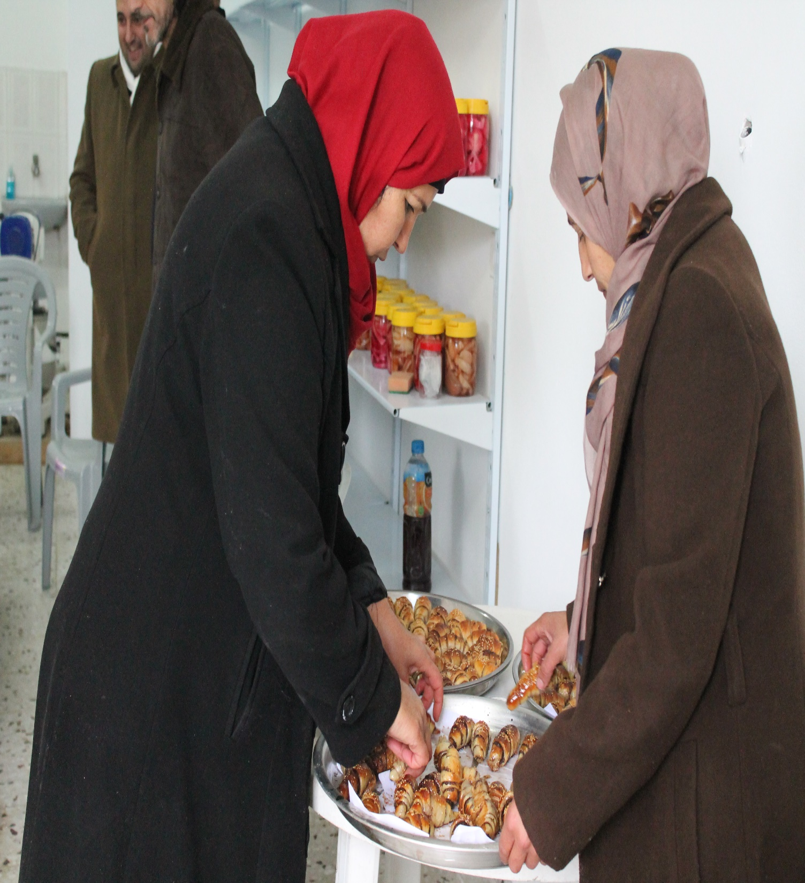

Slide 15
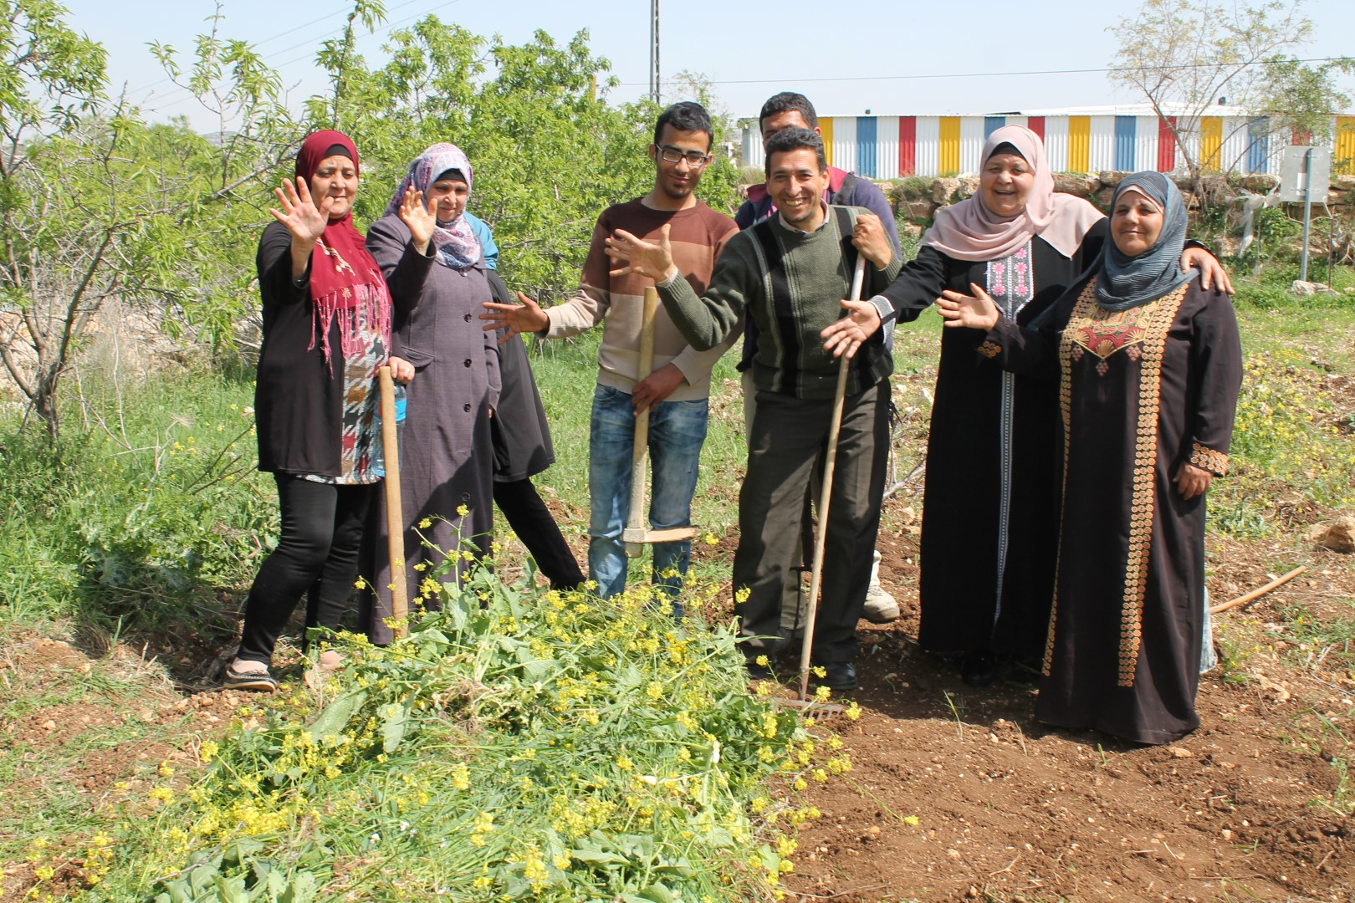

Slide 16
Thank you ☺

