Slide 2
Jordan

Slide 5
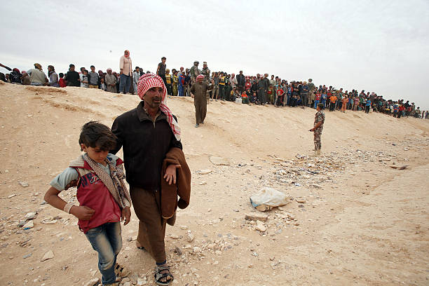
In this way the refugees are crossing border to jordan

Slide 6
Number of Syrian refugee in Jordan
Registered refugees with UNHCR inside camps | 121,000 | Within four official camps
Registered refugees with UNHCR outside camps | 536000 | Inside all Jordanian cities
Not registered | 1000000 | Inside all Jordanian cities
Total | 1657000

Slide 7
Youth in Refugee
51.2% from Syrian refugee in Jordan are youth age under 17 years old
24.9% from this percentage are female and the rest are boys
A lot of refugee are not registered and living in Random refugee camps

Slide 8
SEEDS
Seeds of Hope
We will live together, accept each other, and share the good and the bad

Slide 9
Where is our project

Slide 10
What is Seeds of hope
One of SEEDS projects ,It is a volunteer-run grassroots project that sponsors Random refugee camp at north of jordan .6 Km south of Syrian border and provides workshops for Syrian refugee children and Support families to live with Dignity

Slide 11
.We use music, art, sports, photography and team-building activities to teach the kids about trust and unity and help them deal with the trauma they have sustained. Our workshops provide open dialogue, giving the kids a safe space to tackle the issues that they face and develop their own ideas and visions for thier future

Slide 12
Why we are there
seeds of hope projects comes because in SEEDS we believes that every child has the right in the education, to a childhood free from trauma and violence, and to the hope of a peaceful tomorrow.

Slide 13
Facts
The Syrian children are the most affected victims in the recent conflict. They have lost their homes, their friends, and their schools, and many have lost family members. These children have sacrificed everything that is familiar to them for a revolution that they cannot even begin to comprehend.

Slide 14
Describing for children situation in the camp
Today half of Syrian refugees in the camp are children; some have known nothing but war and refugee camps for their whole lives, and many have limited or no access to education, therapy, or any recreational activities

Slide 15
seeds of hope makes innovative use of sports, arts, and other activities not present in the camps to support the mental, emotional, and physical well-being of the children and to give them a chance to just be kids again

Slide 16
The school
Seeds of hope fully runs a refugee school in the camp that established by Seeds efforts and also supports We provide school supplies for the children – pencils, books, erasers, colouring books, notebooks – in addition to art supplies and soon sports equipment

Slide 17
We used a tent as A class room
Then we replaced it with caravan

Slide 18
And then
More equipments

Slide 19
More equipment

Slide 20
. We want the kids to have a place to go every day to learn and grow, and we fully support the teachers who are doing the important work of educating next generation.

Slide 21
Commitment toward kids
We are committed to these kids and to providing them with every opportunity we can as they grow up in an environment that deprives them of even the most basic services.

Slide 22
volunteers

Slide 23
Our volunteers

Slide 24
Another Commitment
we are helping the families at refugee camp to become strong, capable and productive members of society ready to rebuild their families and country

Slide 26
jouthoor

Slide 27
Achievement
* 1200 hectare were planted with 150000 forest and fruit trees
* 8200 students from school , universities and youth centers were part from this project ,

Slide 28
Conclusion
Youth have capability and possibility to be the key of change when have the opportunity

Slide 29
Thank you

