Slide 1
IMPLEMENTING THE SDGs AND MONITORNG PROGRESS AT THE COUNTRY LEVEL: OPPORTUNITIES, TOOLS AND EXPERIENCES
Presentation made at the ILC Global Land Forum
26th September, 2018, Bandung, Indonesia
More information: www.gltn.net / Twitter: @LandIndicators @gltnnews

Slide 2
The Global Land Indicators Initiative (GLII)
A global multi-stakeholder platform of over 50 partners
Founded in 2012- by World Bank, Millennium Challenge Cooperation and Global Land Tool Network (GLTN) ATUN Habitat,
GLII is hosted and facilitated by GLTN in UN Habitat
Mission: Make global scale monitoring of land governance a reality
Aligned to –VGGTs, SDGs, NUA; and AU-F&G, Agenda2063
•Mandate:
Coordinate, convene and facilitate dialogues between land and data communities, other stakeholders on land governance monitoring, post 2015 agenda
Develop global comparable and nationally applicable land indicators, methodology, tools and protocols for comparable data,
Awareness and advocacy on land governance monitoring and impact evaluation
Facilitate access to technical support for capacity strengthening for harmonized approaches in land governance monitoring including gender disaggregated data, new data technologies.
Research and knowledge management – papers, assessments and studies on land governance monitoring.
Data to reporting on land governance- track progress and trends at all levels.

Slide 3
Why Land in SDGs Matter
Keeps land on the global policy agenda: land underpinning various goals: 1, 2, 5, 11, 15, 16.
SDG is generating sense of focus and urgency for evidence based policy dialogues.
More and better data generated by NSO, cadasters/registries and other data contributing agencies are key for policy decisions
For example: how land governance affects food security, gender, urban development, land degradation and environmental sustainability, peace and stability.

Slide 4
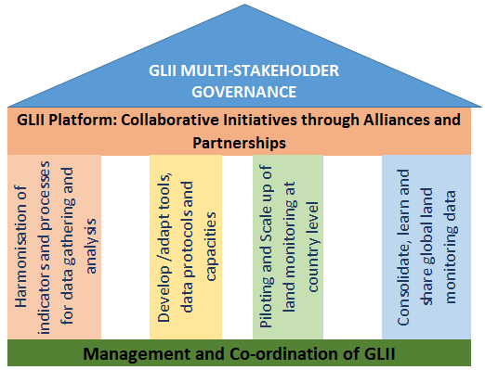
Mission Delivery – Implementation
Open and harmonised framework of global land monitoring
World Bank, UN agencies, others
GLTN
Global Partners
Country Government, Networks & Civil Society
Bilateral /multi lateral initiatives and partners country level
National Partners
LPI
UNECA others
Regional Partners
GLII is built on a collaborative structure with partners

Slide 5
Global Land Indicators (15) for Monitoring Land Governance Issues for Comparable Data
Feasibility study on use of comparable land indicators for monitoring at scale – showed was feasible.
15 set of comparable land indicators categorized into four categories
Land tenure Security
% of men and women with legally documented rights
% of men and men with perceiving their land tenure as free from eviction/dispossession
Legal protection of rights and use derived from plurality of tenure regimes.
Equal rights of women and men – to own, inherit, transact
Indigenous people and community groups with claims over land; % of land utilized, legal recognition/evidence of their rights.
Land Administration
Time and cost to conduct transaction
Land information is available and accessible to public
User access to and use of land admin services by sex
Land tax amount collected as a % of the total government revenue
Proportion of land areas with rights holders in cooperated in national cadasters/land information system.
Land and Conflict
Men, women, IP- who have experienced conflict/dispute – by sex, type of tenure and conflict/dispute
Availability and accessibility to dispute resolution mechanism, affordable for women and men.
Effectiveness of mechanism - # of cases reported by year and had conflict/dispute resolved.
Sustainable Land Use and Management
National change in aggregate land use sustainability measured by change in
i) land cover/land-use change;
iii) soil organic carbon change
Proportion of rural and urban administrative areas/ units whose land use change/development are governed by sustainable land-use plans including interests of the local land users and land owners

Slide 6
2030 Agenda for Sustainable Development
1 Agenda 5 Main Areas 17 Goals 169 Targets 240 Indicators

Slide 7
Improving Land Tenure Security to end Poverty
Global Recognition of the Importance of Land Rights for Sustainable Development

Slide 8
Where is Land in SDGS
SDGs – 17 goals, 169, targets, 240 indicators
2030 Agenda contains land-related targets and indicators
Explicitly Included in: SDGs 1, 2, 5, 11 and 15.
Not explicitly mention in SDG16 – though land is key to peace and stability.
9 Targets and 12 indicators related to land
Targets – 1.4 (Indicator -1.4.2 on tenure security)
Target 2.3 (Indicators - 2.3.1 and 2.3.2 addressing smallholder farmers)
Target 2.4 (Indicator – 2.4.1 on agricultural area)
Target 5.a (indicators- 5.a.1 – securing women’s agricultural land, and 5.a.2 on legal framework on securing women’s land)
Target 11.1 ( Indicators -11.1.1), 11.3 (indicator- 11.3.1) and Target 11.7 (indicator -11.7.1) addressing urban informality and access to housing; open spaces and land consumption rate.)
Target 15.1 (indicators 15.1.1, 15.1.2) on forest areas, biodiversity; and Target 15.3 (indicator -15.3.1) on land degradation neutrality).
SDG16 – No explicit indicators linked to land in the SDGs, GLII indicators does.

Slide 9
Countries Preparedness to Collect and Report on Land Indicators
Most land indicators in the SDGs are Tier II Indicators as classified by the Inter-Agency Expert Group on SDGs (IAEG-SDGs)
Tier 1: Indicator conceptually clear, established methodology and standards available and data regularly produced and reported by over 50% countries globally.
Tier 2: Indicator conceptually clear, established methodology and standards available but data are not regularly produced by countries.
NB: NSOs and other data agencies uptake the methodology for data collection.
Tier 3: Indicator for which there are no established methodology and standards or methodology/standards are being developed/tested.

Slide 10
Data sources
Household surveys and census
Integrating essential SDG questions on legally recognized documentation and perception of tenure security in existing survey instruments
Administrative data
Land records on legally recognized documentation held by land registries and cadasters in electronic formats
Geospatial Data
Big data
Data from CSOs, Private Sector, GDWGL and other development agencies
DATA DISSAGREGATE BY SEX , POPULATION AND TENURE TYPE, OTHERS …

Slide 11
Securing Women’s Land in the SDGs

Slide 13
Status of the SDGs Land Related Indicators – 3rd Year into SDGs implementation; Towards 2030
2015: SDG land related indicators in SDG framework
Strong mobilization and lobbying by global land community – facilitated by GLII and Global Donor Working Group on Land on 1.4.2 and other indicators.
Most indicators: 1.4.2, 5.a.1, 5.a.2, 11.1.1 and 15.3.1- classified as Tier III.
GLII coordinated and facilitated broad engagement with NSOs, Land Agencies, CSOs, GDWGL, ILC, LPC, ACS and others.
Expert groups meetings
Custodians engagement and technical inputs to metadata and methodology development
Multi-country capacity assessment on preparedness to collect and report on tenure security; and country pilots
Advocacy at UN High Level Political Forum – 2017, 2018 and other policy spaces.
Establishment of the GDWGL – Friends of Custodian Group (to support reclassification and data efforts for land indicator 1.4.2 and 5.a.1).

Slide 14
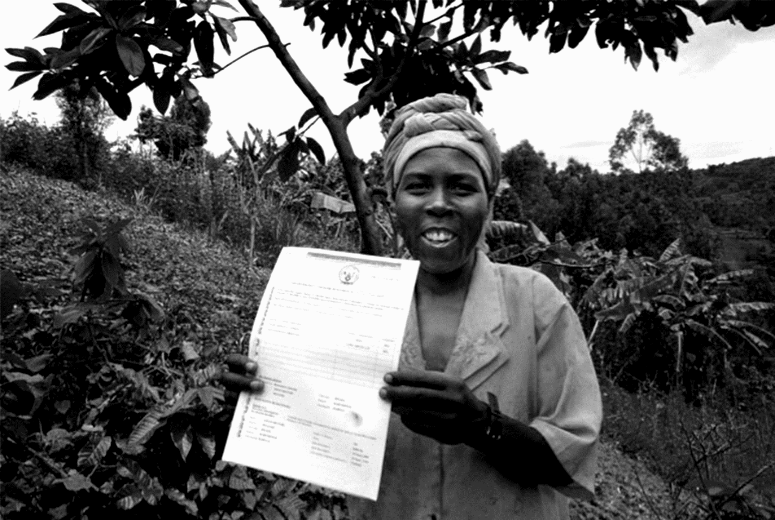
Harmonization of data collection
Close coordination with FAO and UN Women custodians of 5a.1: (a) Proportion of total agricultural population with ownership or secure rights over agricultural land, by sex; and (b) Share of women among owners or right-bearers of agricultural land, by type of tenure.

Slide 15
Cont: Status of Land Indicators
Coordinated and supported harmonization of indicators 1.4.2 and 5.a.1
Custodians addressed definitions, concepts and data sources
Developed joint questionnaire module for data collection, compute the two indicators
Developed NSOs guide for data collection using the joint module.
By Nov 2017: Most indicators acquired Tier II Status
Internationally agreed methodology
No complete data yet
But, National Statistical Organizations (NSO) will now include this indicator in data collection strategy/ priorities
Target: Achieve Reclassification to Tier I by 2020
50% of all countries ; 50% of population – by regions
Countries data status analyzed– 1.4.2 and 5.a.1;
Master file of priority countries developed – to guide efforts, synergy and avoid duplication.

Slide 16
What is/Need to Happen Now?
Dissemination of approved methodologies to NSOs, land registries/cadaster, CSOs, private sector and other agencies
Technical session for NSOs – focused on 1.4.2 and 5.a.1 at the margins of UN World Data Forum in October 2018.
Country support for data collection – data agencies including NSOs and national land registries to be supported- target of 97 countries by 2020.
Support and link with other data efforts – PRIndex, ILC Dashboard, Monitoring and Evaluation of Land in Africa (MELA), other initiatives– GLII goes beyond the SDGs.
Awareness, advocacy for prioritization of SDGs monitoring and localization at country and regional level
Engagement with regional land and statistical agencies/training institutions and others
Development of communication and awareness materials, tools and guides to better support/inform the data collection process.
Country support in development of National Voluntary Reviews (NVR) for HLPF (based on selected SDGs)

Slide 17
WE ALL HAVE ROLE TO PLAY!!

