Slide 1
Data Driven advocacy for SDGs Gender Targets in Kenya
Presented at the Global Land Forum
@
Bandung, Indonesia

Slide 2
About Us
GROOTS Kenya is a national movement of grassroots women. Membership of over 3,500 women-led groups. Presence in 16 Counties in Kenya.
Grassroots women and their communities are not vulnerable recipients of charity/aid but effective change agents with the capacity to determine their own development.
Mission: Facilitate effective engagement of grassroots women and their communities in development spaces at local, national and global spaces

Slide 3
SDGs County Dialogues
GROOTS Kenya was very active in tracking the MDGs and in the post 2015 discussions.
Awareness creation around SDGs at the county level
Community understand the SDGs in the Local Context and identify the targets that they would like to track.
Development of SDGs champions

Slide 4
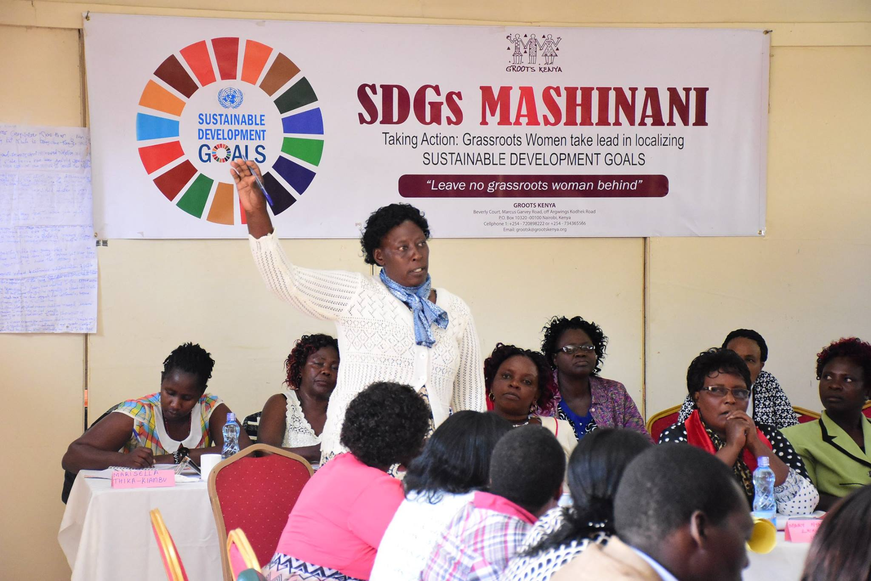
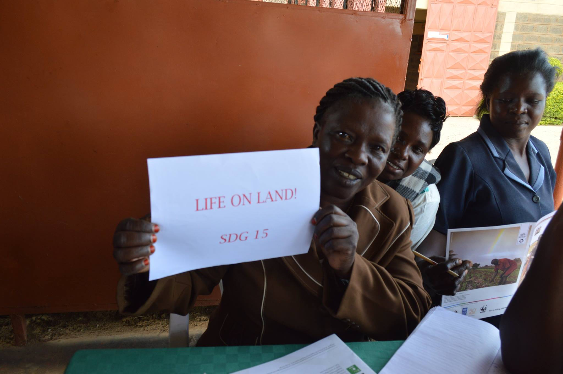

Slide 5
Developing SDGs Data Advocates
Using the Data for Advocacy -A Facilitator’s Guide
MODULE 3: Why do we need data?
MODULE 4: Where does data come from?
MODULE 5: How is data analyzed ?
MODULE 6: How is data quality determined? The politics of data
MODULE 7: Who uses data?
MODULE 8: How to communicate data?
MODULE 9: SDGS & National & County Policy making processes?
MODULE 10: How do we expand our influence? The global movement for gender equality?
MODULE 11: How do we work together?
Use of digital technology to collect data
60 Data Advocates developed

Slide 6
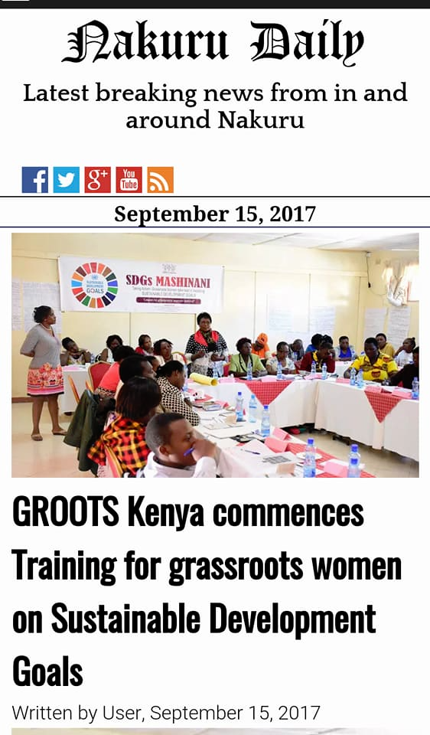

Slide 7
Participatory SDGs Tracking Tool Development

Slide 9
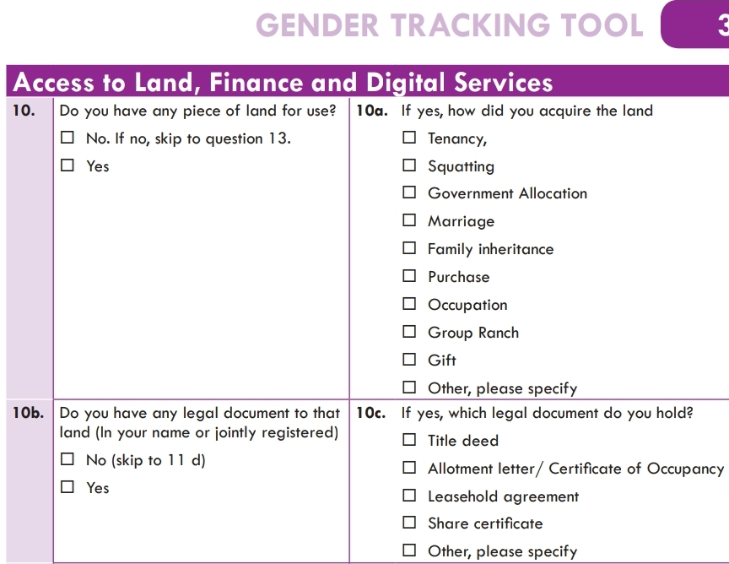

Slide 10
Studies: Gap analysis on progress made in Gender Based Planning in Kenya,
Community own generated data-County/locals statistics : SDGs Gender Tracking Tool
Land Registries,KNBS, VNRs, Country Position Papers

Slide 11
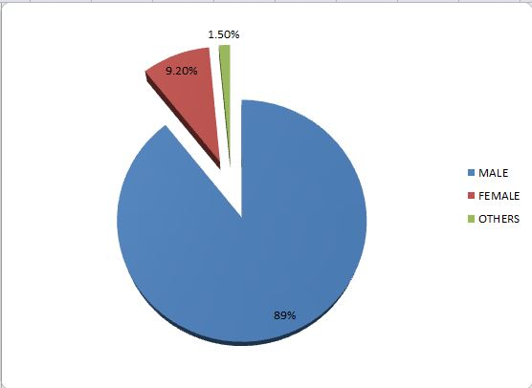
Butsoso Location: Ownership of Private Land by Gender

Slide 12
Butsoso Location-ownership by gender ( land size)
Land parcels that are exclusively registered under females account for 4.6% of total registered land
Land parcels that are exclusively registered under males account for 88.35%
Land parcels that are registered under both males and females account for 7.04%

Slide 13
Women Representation in Community Land Governance-Laikipia County
Name of Community Group Ranch | Number of registered occupants | % Male percentage | %Female percentage
1) Kijabe group ranch | 123 | 100 | 0
2) Musul group ranch | 336 | 99.7 | 0.3
3) Munishoi group ranch | 58 | 98.33 | 1.67
4) Nkiroriti group ranch | 176 | 100 | 0
5) Ilipolei group ranch | 161 | 97.52 | 2.48
6) Koija group ranch | 590 | 69.33 | 30.67
7) Ilmotiok group ranch | 262 | 91.67 | 8.33
8) Murpusi Group ranch | 923 | 99.02 | 0.98
9) Tiamamut Group ranch | 907 | 63.62 | 36.38

Slide 14
Delivering the Advocacy: Coalition Building
SDGs Kenya Forum
HIVE-Team of Local Celebrities
Women2Kilimanjaro,Land Sector non State Actors

Slide 15
Voluntary National Reporting
SDGs Kenya Forum which GROOTS Kenya is a member has a formal working relationship with the SDGs unit, Ministry of National Treasury and Planning
GROOTS Kenya participated in the preparation of VNR 2017 where governments were reporting on Goal 1 and draft position paper 2018.GROOTS Kenya joined the Kenya Delegation to HPLF

Slide 16
Selected SDGs |  |  |  |  |  |  | Selected SDGs
CSO partners/ Consortium |  |  |  |  |  |  | CSO partners/ Consortium
Target(s) | Brief problem description/ current status | Key CSO(s) Intervention(s) | Key Outcome(s)/ Achievement(s) | Challenges | Key messages | Recommendations for enhancing implementation of the 2030 agenda | Target(s) | Brief problem description/ current status
Indicator(s) | Brief problem description | CSO Intervention(s) | Outcome(s)/ Achievement(s) | Challenges | Key messages |  | Indicator(s) | Brief problem description

Slide 17
VNR: Annex
As evidence to support the information provided in the template:
Reports/brief
Statistical/data analysis or visualisations
Links to online reports/briefs or websites or videos
Etc.

Slide 19
Key Progress
Adoption of rural women land rights charter & Implementation by Ministry of Lands :

Slide 20
Broad Changes agreed between W2K& Ministry of Lands in the Implementation Framework
Enhanced Access to information on women land right status
Eradication of inequalities and discrimination on women access and control to land
Accessible and administrative land and justice systems for women

Slide 21
Asante!

