Slide 1
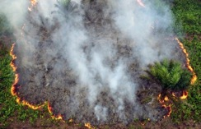
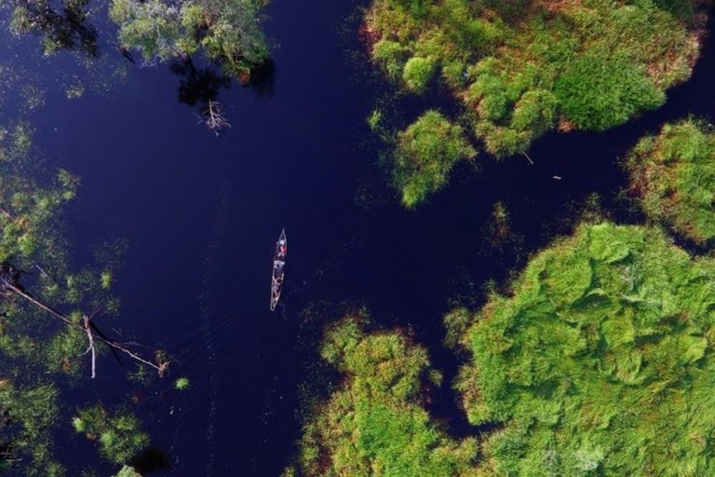

Slide 2
Community maps used for :
Resolving conflict between community areas where overlaping with other sector claim (forestry, permit)
Use for basis of IP's recognizing
Basis for social forestry scheme, Agrarian Reform object areas
Village boundary setting and village planning, we hope this initiative can integration with district spatial planning
Indonesia Community Mapping Network
Jaringan Kerja Pemetaan Partisipatif (JKPP)
JKPP established in 1997
Until now we have 210 members (NGO, individual, academics
28 Service centre in 24 Province In Indonesia to accelerating community mapping

Slide 3
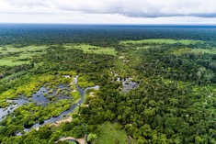
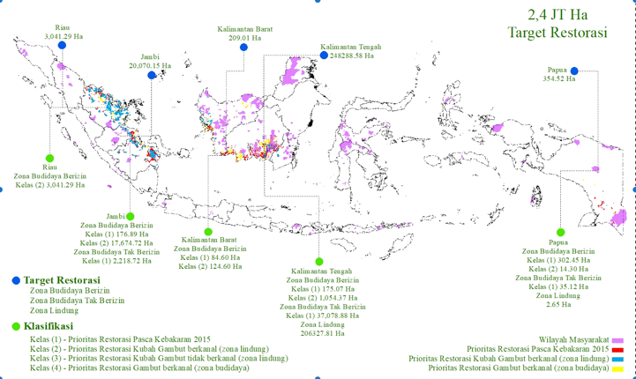
Background
Indonesia has 14,850 M Ha Peatland Areas
BRG (Indonesia Peatland Restoration Agency) established by Presidential Decree
Main Task :
Until 2019, 4,5 M Ha should be Restoration
Restoration : Rewetting & Revegetation
There are 1200 villages on peatland
The communities have traditional knowledge to managing a peatland for livelihood
Threat :
Community areas are the target of peatland restorastion
trend of investment expansion (Palm Oil)

Slide 4
Tanjung Taruna village is located in 2 Peat Hydrological Area Kahayan - Sebangau and Kahayan – Kapuas on Central Kalimantan
This village is a priority villages of the Peat Ecosystem Restoration program supported by Indonesian Peatland Restoration Agency
One of the lakes that part of this village community management is Lake Bagantung.
The communities in the villages has a traditional knowledge to manage the peatland areas, and has a rules for fish catching
Lake Bagantung is one of the lakes located in Tanjung Taruna village, is a place of habitat of various types of peat swamp fish
Peat swamp forests around of Lake Bagantung have been a place where people are taking non-timber forest products (NTFPs) such as purun, rattan, traditional medicines
The threat to Lake Bagantung today is fishing electrofishing, poisoning by outsiders and the trend of investment expansion (Palm Oil)

Slide 5
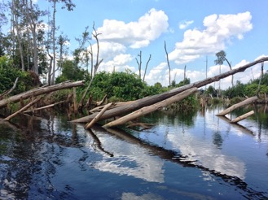
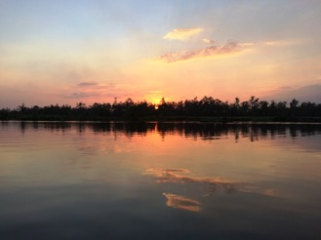
Community Initiative
Reject palm oil investment expansion
Encouraging the recognition through local regulation (District, Province Level)
Registrating of Lake Bagantung to ICCA Registry
Opportunity : Revision of the Biodiversity Conservation and Ecosystem Law (UU KKHE No 5) which is currently being pushed to include the Nomenclature of Protecting Community Conservation and Management Areas

