Slide 1

Governance of Domestic Investment into Land
Session by the Global Donor Working Group on Land
Global Land Forum 2018
Bandung, Indonesia, 26 September

Slide 2
Panelists
Justine Sylvester, Advisor to the Land and Livelihoods Program and Private Sector Engagement at Village Focus International (VFI)
Bezualem Bekele Mogessie, Head of the Land Administration Directorate, Ethiopian Horticultural and Agricultural Investment Authority (EHAIA)
Dr. Tran Thi Thuy Hoa, Chairman of the Rubber Development Advisory Board of the Vietnam Rubber Association
MODERATOR: Harold Liversage, Lead Land Tenure Specialist, IFAD.

Slide 3
Key messages
Justine Sylvester, Village Focus International
Domestic investors are not only agribusinesses: a paradigm shift is needed to acknowledge that smallholders are agricultural investors in their own right.
Risks and rewards are both inherent in “private sector engagement”: there’s huge potential for CSOs to work with domestic investors (and local governments) to operationalize global guidance and standards – putting into practice the VGGT, RAI Principles, FPIC, etc.
But civic space is shrinking – particularly for land rights CSOs in the Mekong region. Civil society needs support to continue promoting responsible agricultural investment and engaging with domestic investors.

Slide 4
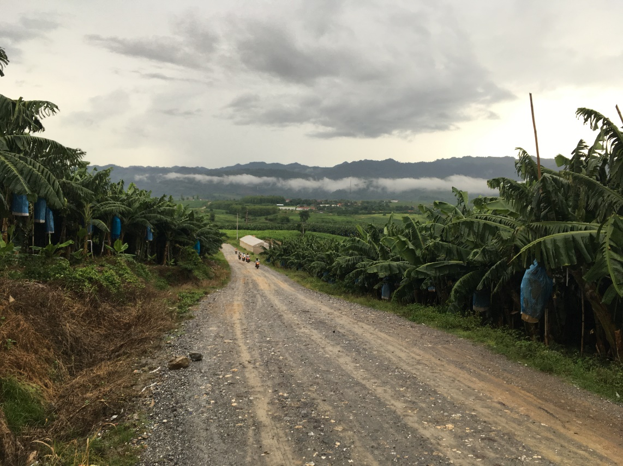
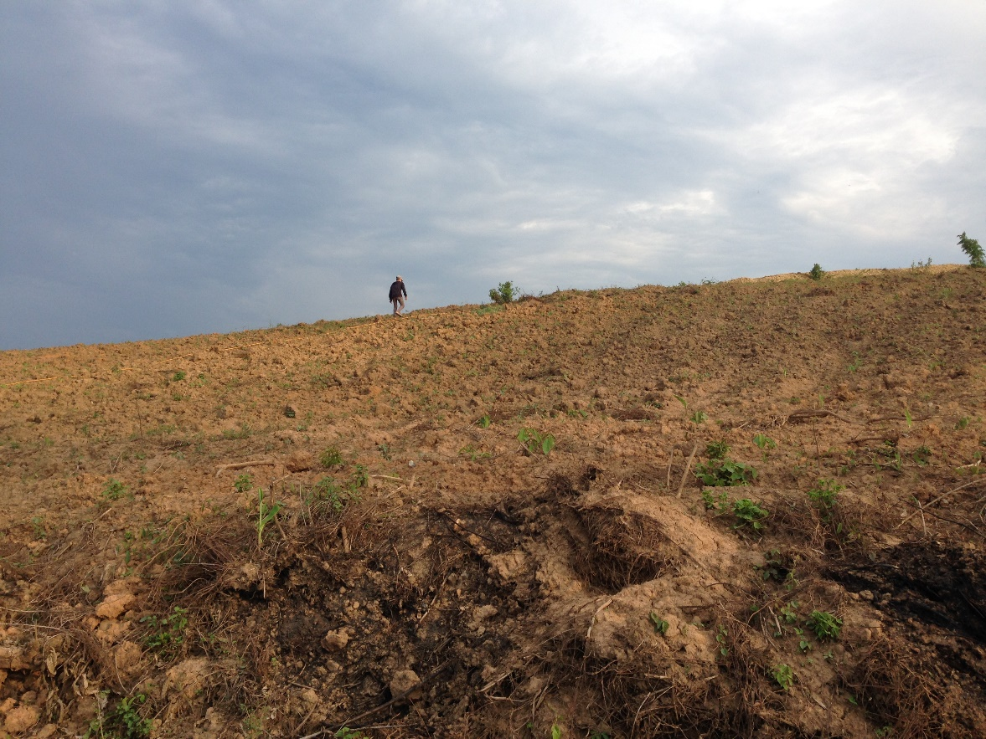
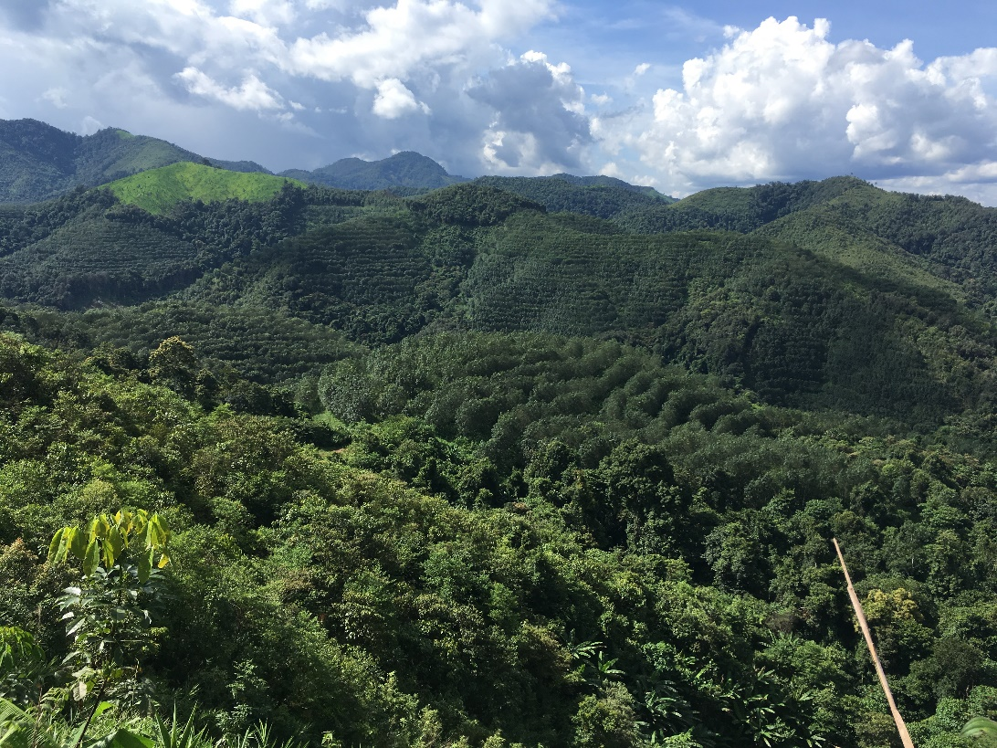
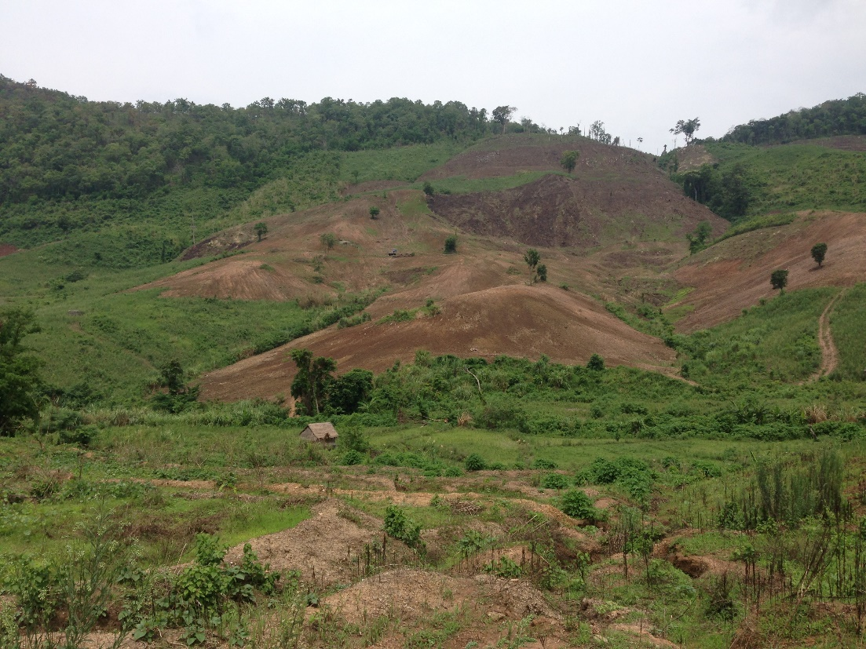

Slide 5
Key messages
Benzualem Mogessie, Ethiopian Agr. Investment Authority
Develop land use policy and land use plan and act accordingly.
Respect local livelihood systems and in case of deterioration involve fully local communities to change their livelihood system.
Capacity building at all levels.

Slide 6
Key messages
Dr. Tran Thi Thuy Hoa, Vietnam Rubber Association
The world demand on natural rubber encourages to develop rubber plantations and creates important income of more than 5 millions smallholders on the area of about 14 million ha.
Natural rubber would be increased in the future and should be supplied by rubber plantations replanted with higher productivity instead of land expansion for new planting.
The professional associations can make the link with agribusinesses and CSOs / NGOs to support farmers and growers developing rubber plantations in sustainability, mitigation for socio-environmental risks and “Zero-deforestation” in rubber supply chain.

Slide 7
Discussion in Groups – 15 min
  What issues were missing or should be emphasized from what panelists presented?
  What is the one thing that you could do going back home to support responsible and sustainable domestic investments?
Select 1 reporter from your group
Write down max. 3 key messages of your discussion

Slide 8
Harvest of ideas…

Slide 9


www.donorplatform.org
romy.sato@donorplatform.org
@donorplatform
www.donorplatform.org/newsletter

